Slide 1


Figure 1
HMMER
ClustalO
Phylo Trees
NCBI/JGI
BLAST
Dataframe
Results
BUSCO
DIAMOND
Graphs
Primary
Literature

Slide 2
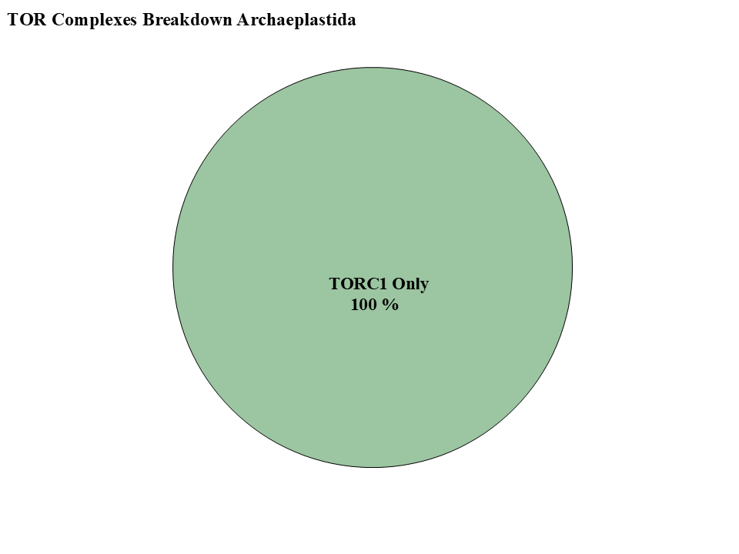
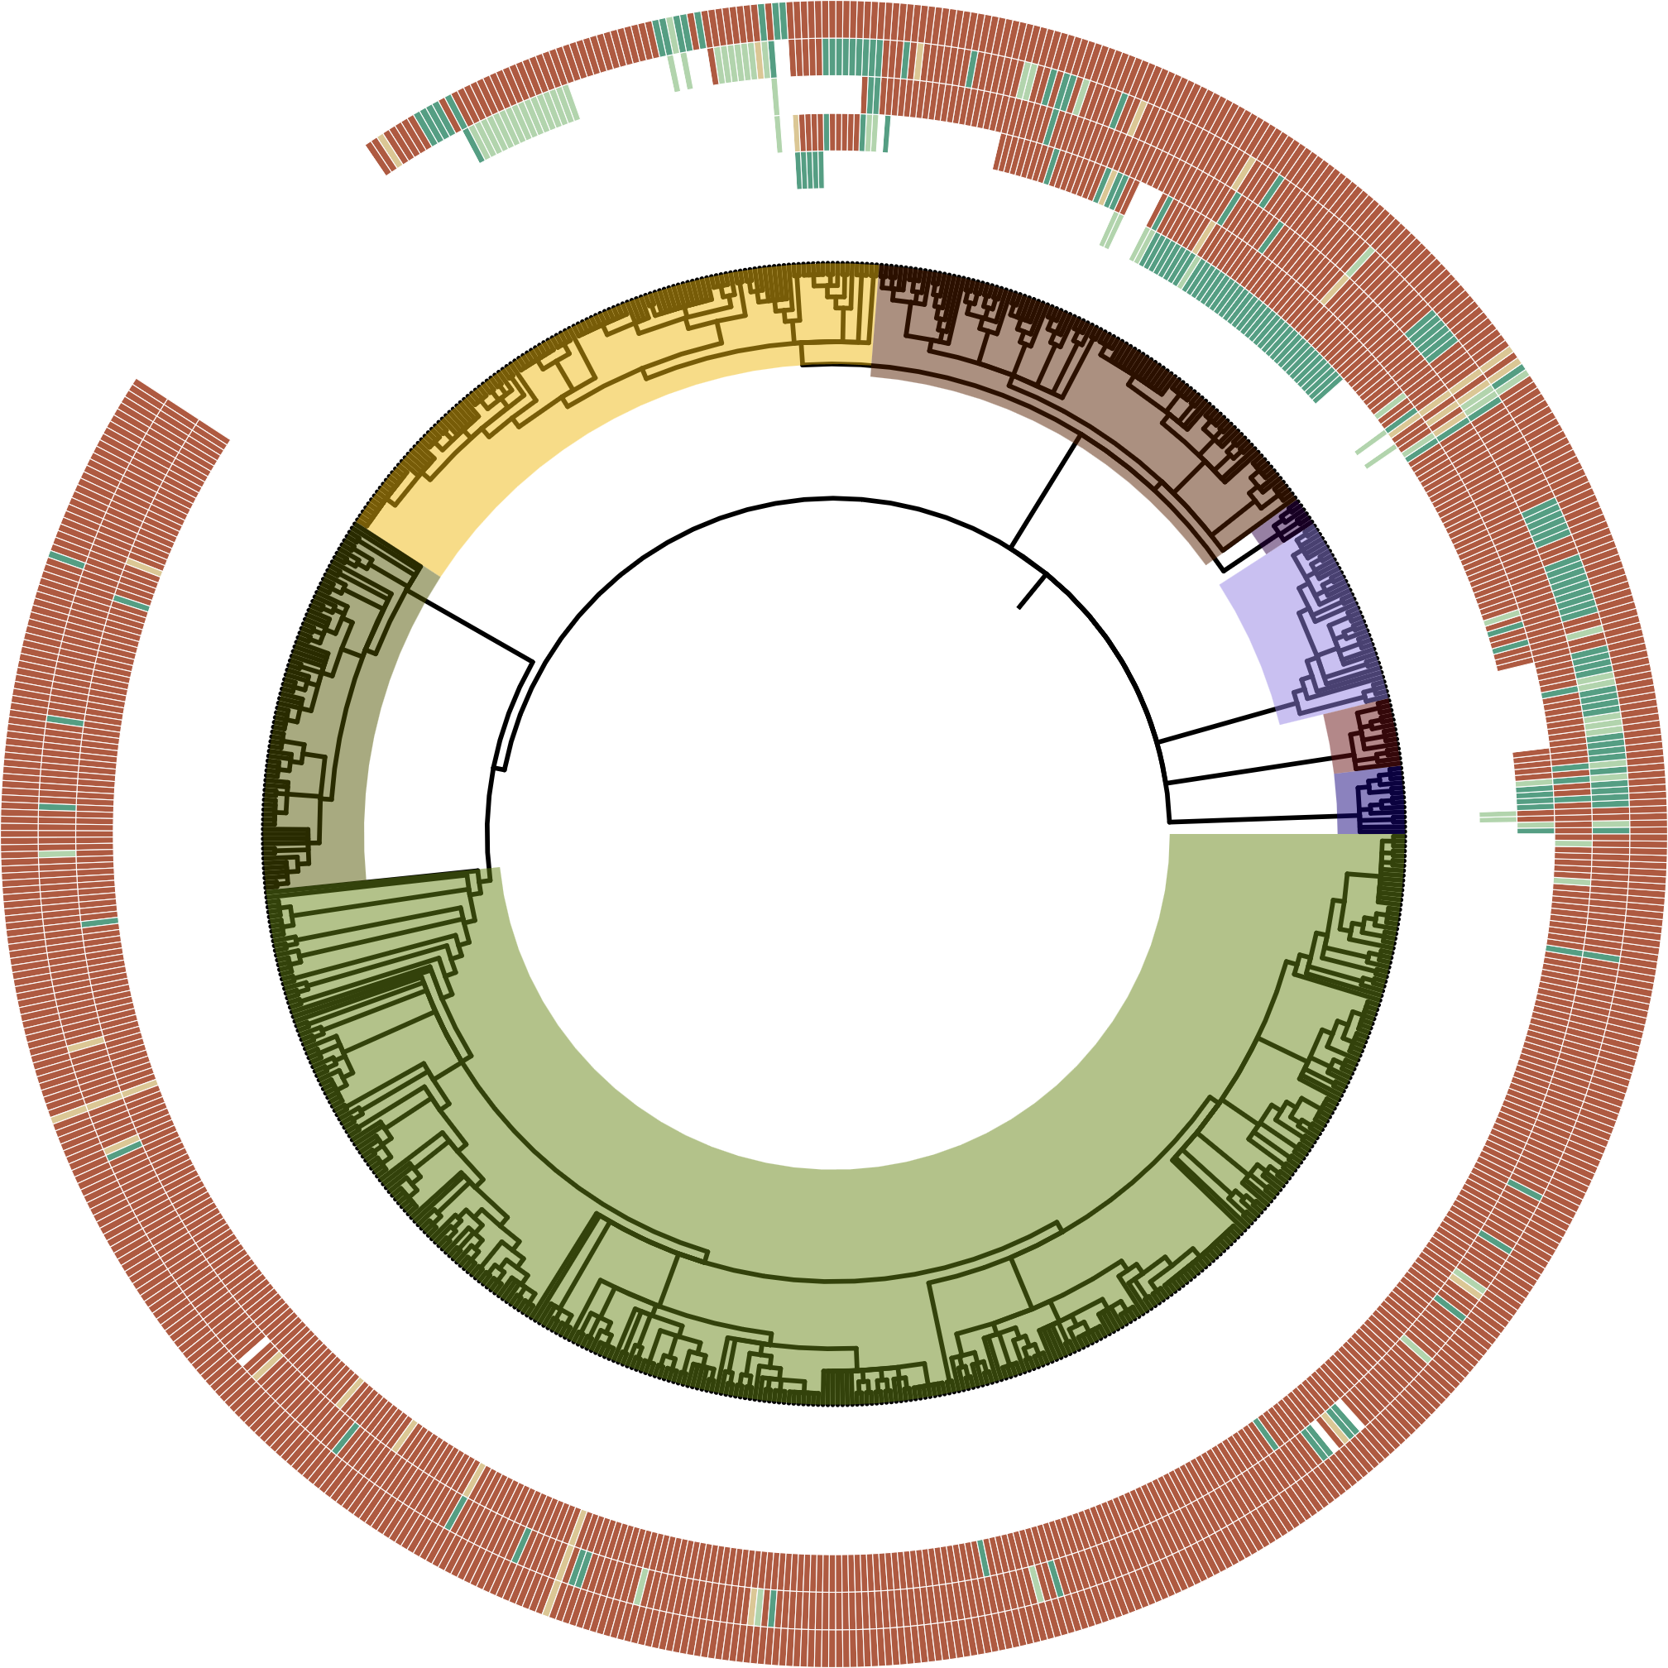
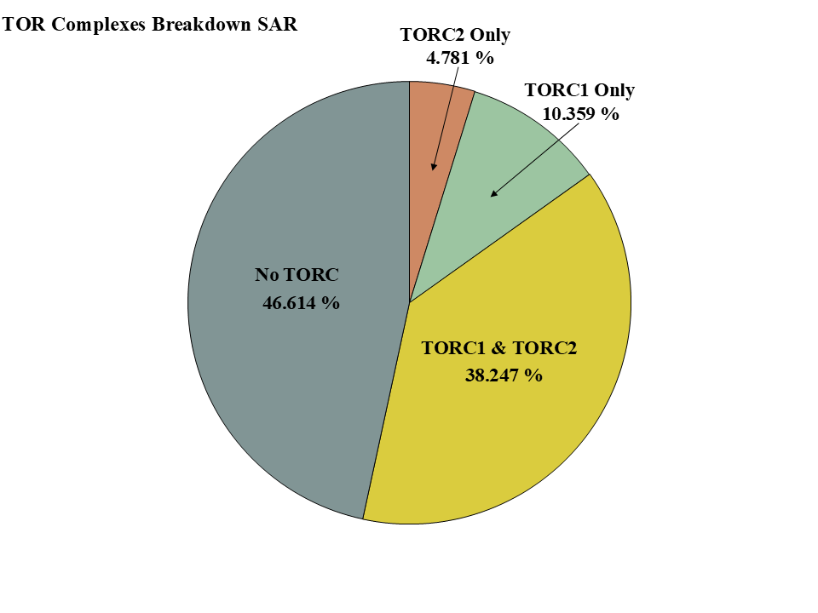
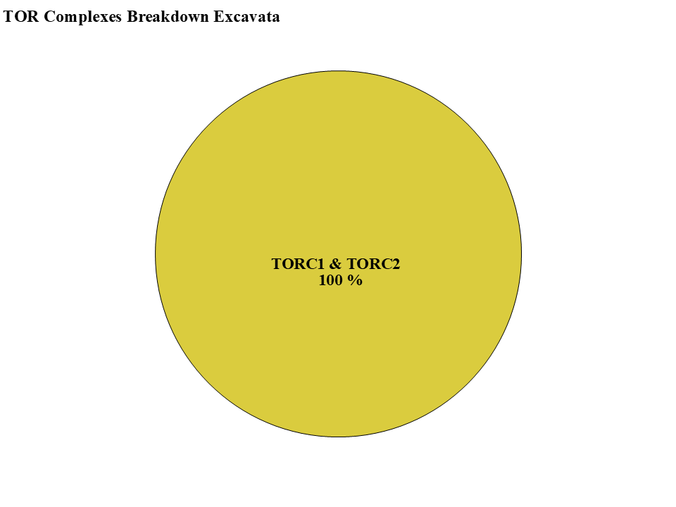
Figure 2
HMMER Score
-TOR-
-LST8-
H
-RAPTOR-
-RICTOR-
-SIN1-
M
L
P
ABS
Clade
Alveolata
Stramenopiles
Rhizaria
Streptophyta
Chlorophyta
Rhodophyta
Discoba
Metamonada

Slide 3
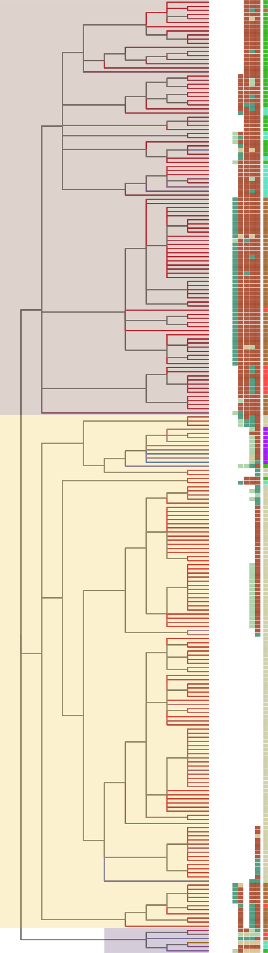

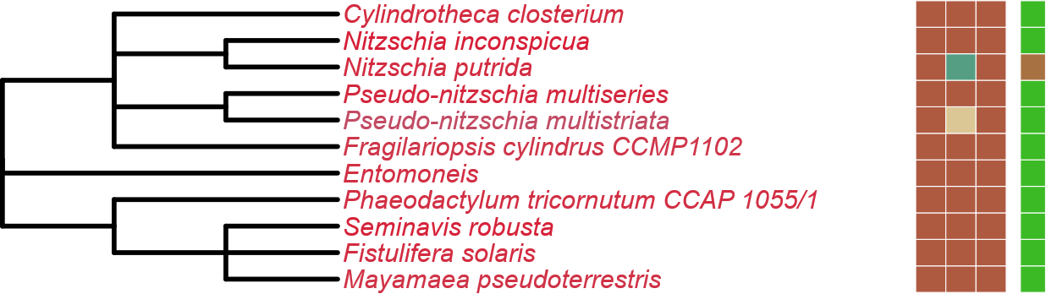
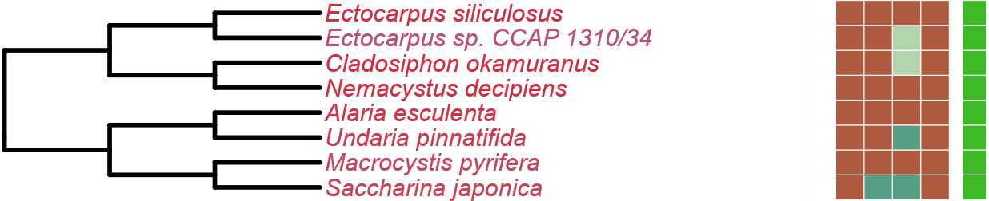
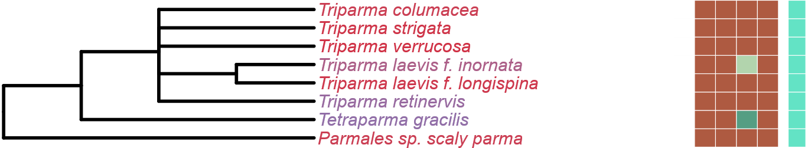
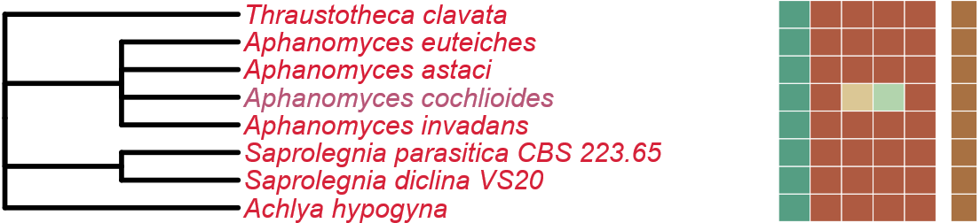
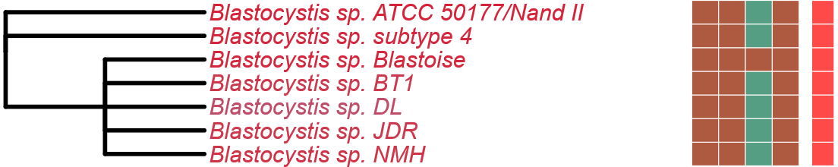
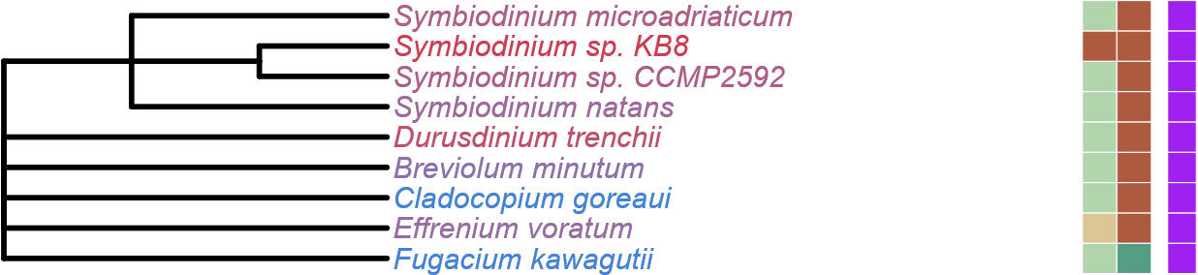
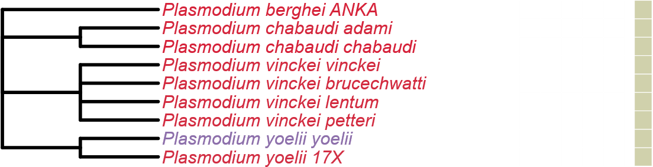
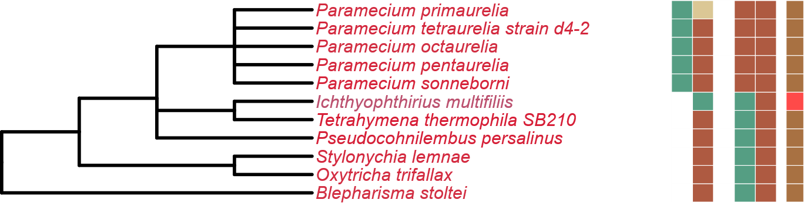
Figure 3
Completeness Score
LST8
100
RICTOR
RAPTOR
SIN1
TOR
75
50
Stramenopiles
25
HMMER Score
H
M
L
P
ABS
Metabolic Strategy
Alveolata
Autotrophic
Heterotroph
Mixotroph
Plastid Parasite
Non-Plastid Parasite
Rhizaria
Endosymbiotic

Slide 4
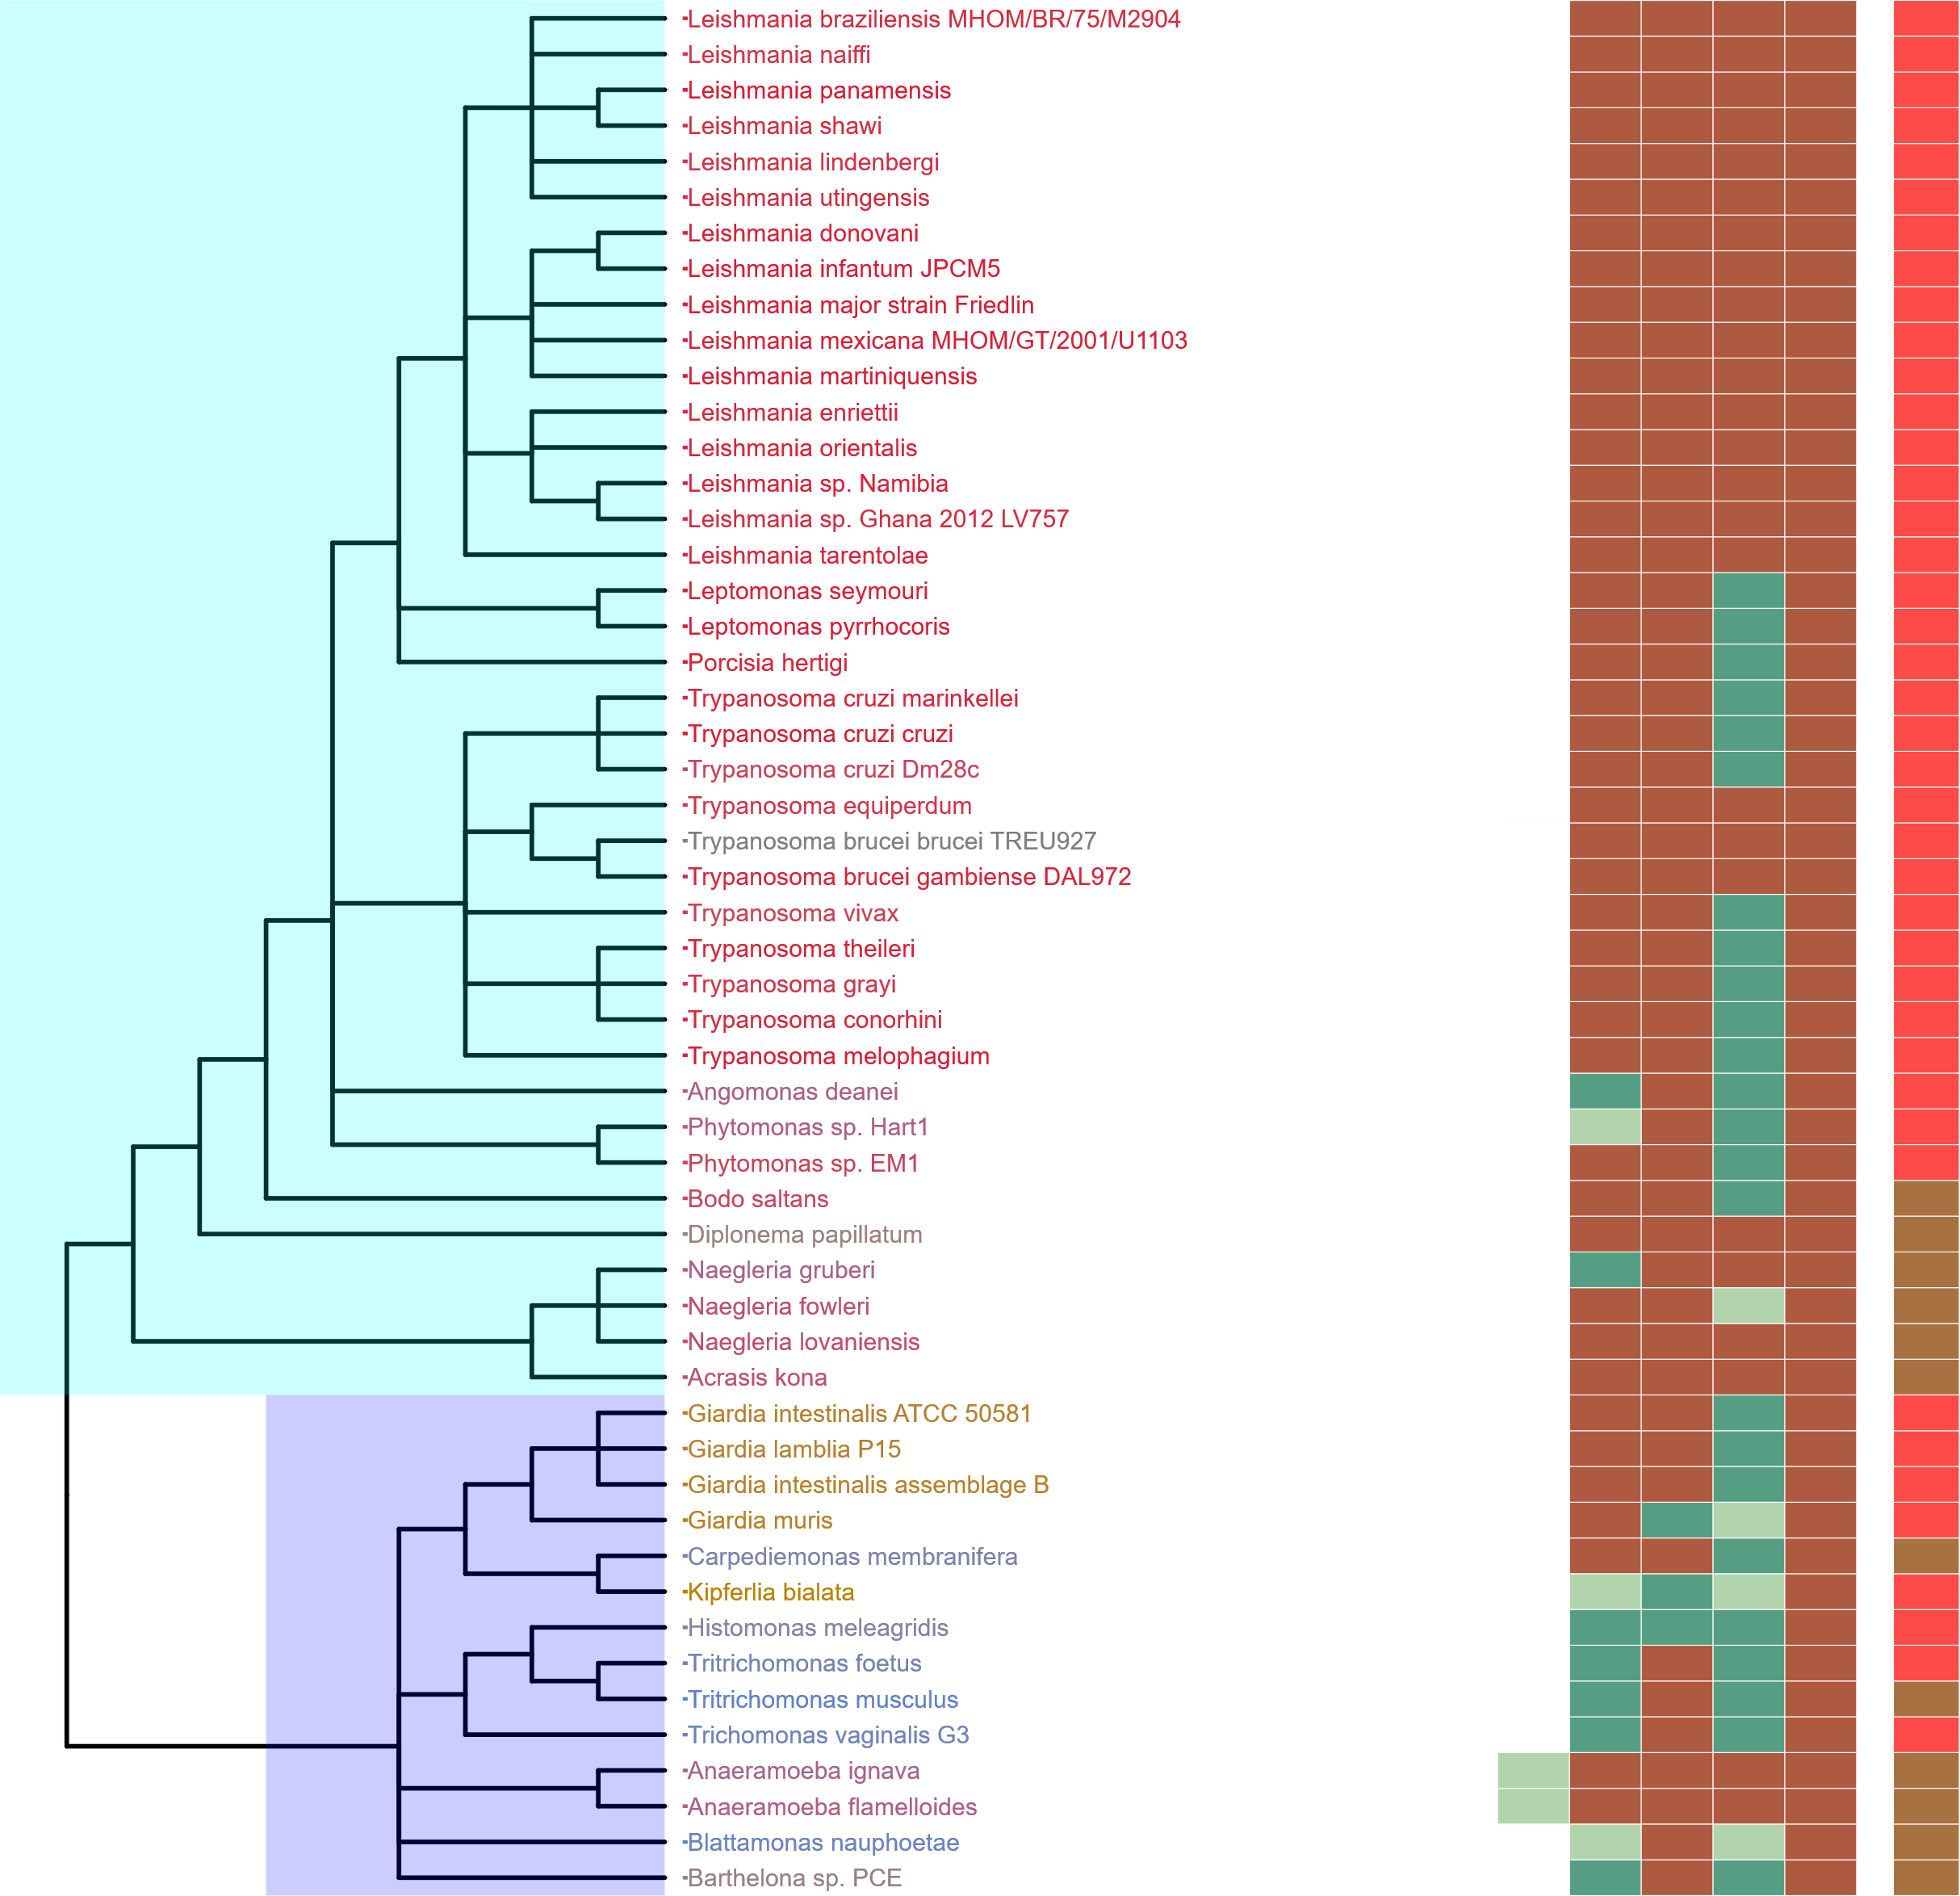
Figure 4
Completeness Score
100
75
50
25
Discoba
HMMER Score
H
M
L
P
ABS
Metabolic Strategy
Autotrophic
Heterotroph
Mixotroph
Metamonada
Plastid Parasite
Non-Plastid Parasite
Endosymbiotic

Slide 5
Figure 5
TORC1
TORC2
Heterotrophic
Mixotrophic
Autotrophic
Non-Plastid Parasites
Plastid
Parasites
Endosymbiotic
Rhodophyta
Archaeplastida
Chlorophyta
TORC1
TORC1
Streptophyta
TORC1 & TORC2
Stramenopiles
LECA
SAR
TORC1
Alveolata
TORC1 & TORC2
TORC2
Rhizaria
Discoba
TORC1 & TORC2
Excavates
TORC1 & TORC2
Metamonada

Slide 6
LECA
Excavata
SAR
Archaeplastida
Metamonada
Discoba
Streptophyta
Chlorophyta
Rhodophyta
TORC1 & TORC2
TORC1
Rhizaria
Alveolata
Stramenopila
TORC1
TORC2
Mixotrophic
TORC1
Autotrophic
Heterotrophic
Non-Plastid Parasites
TORC1 & TORC2
TORC2
TORC1
Plastid
Parasites
TORC1 & TORC2
TORC1 & TORC2
Endosymbiotic

Slide 7
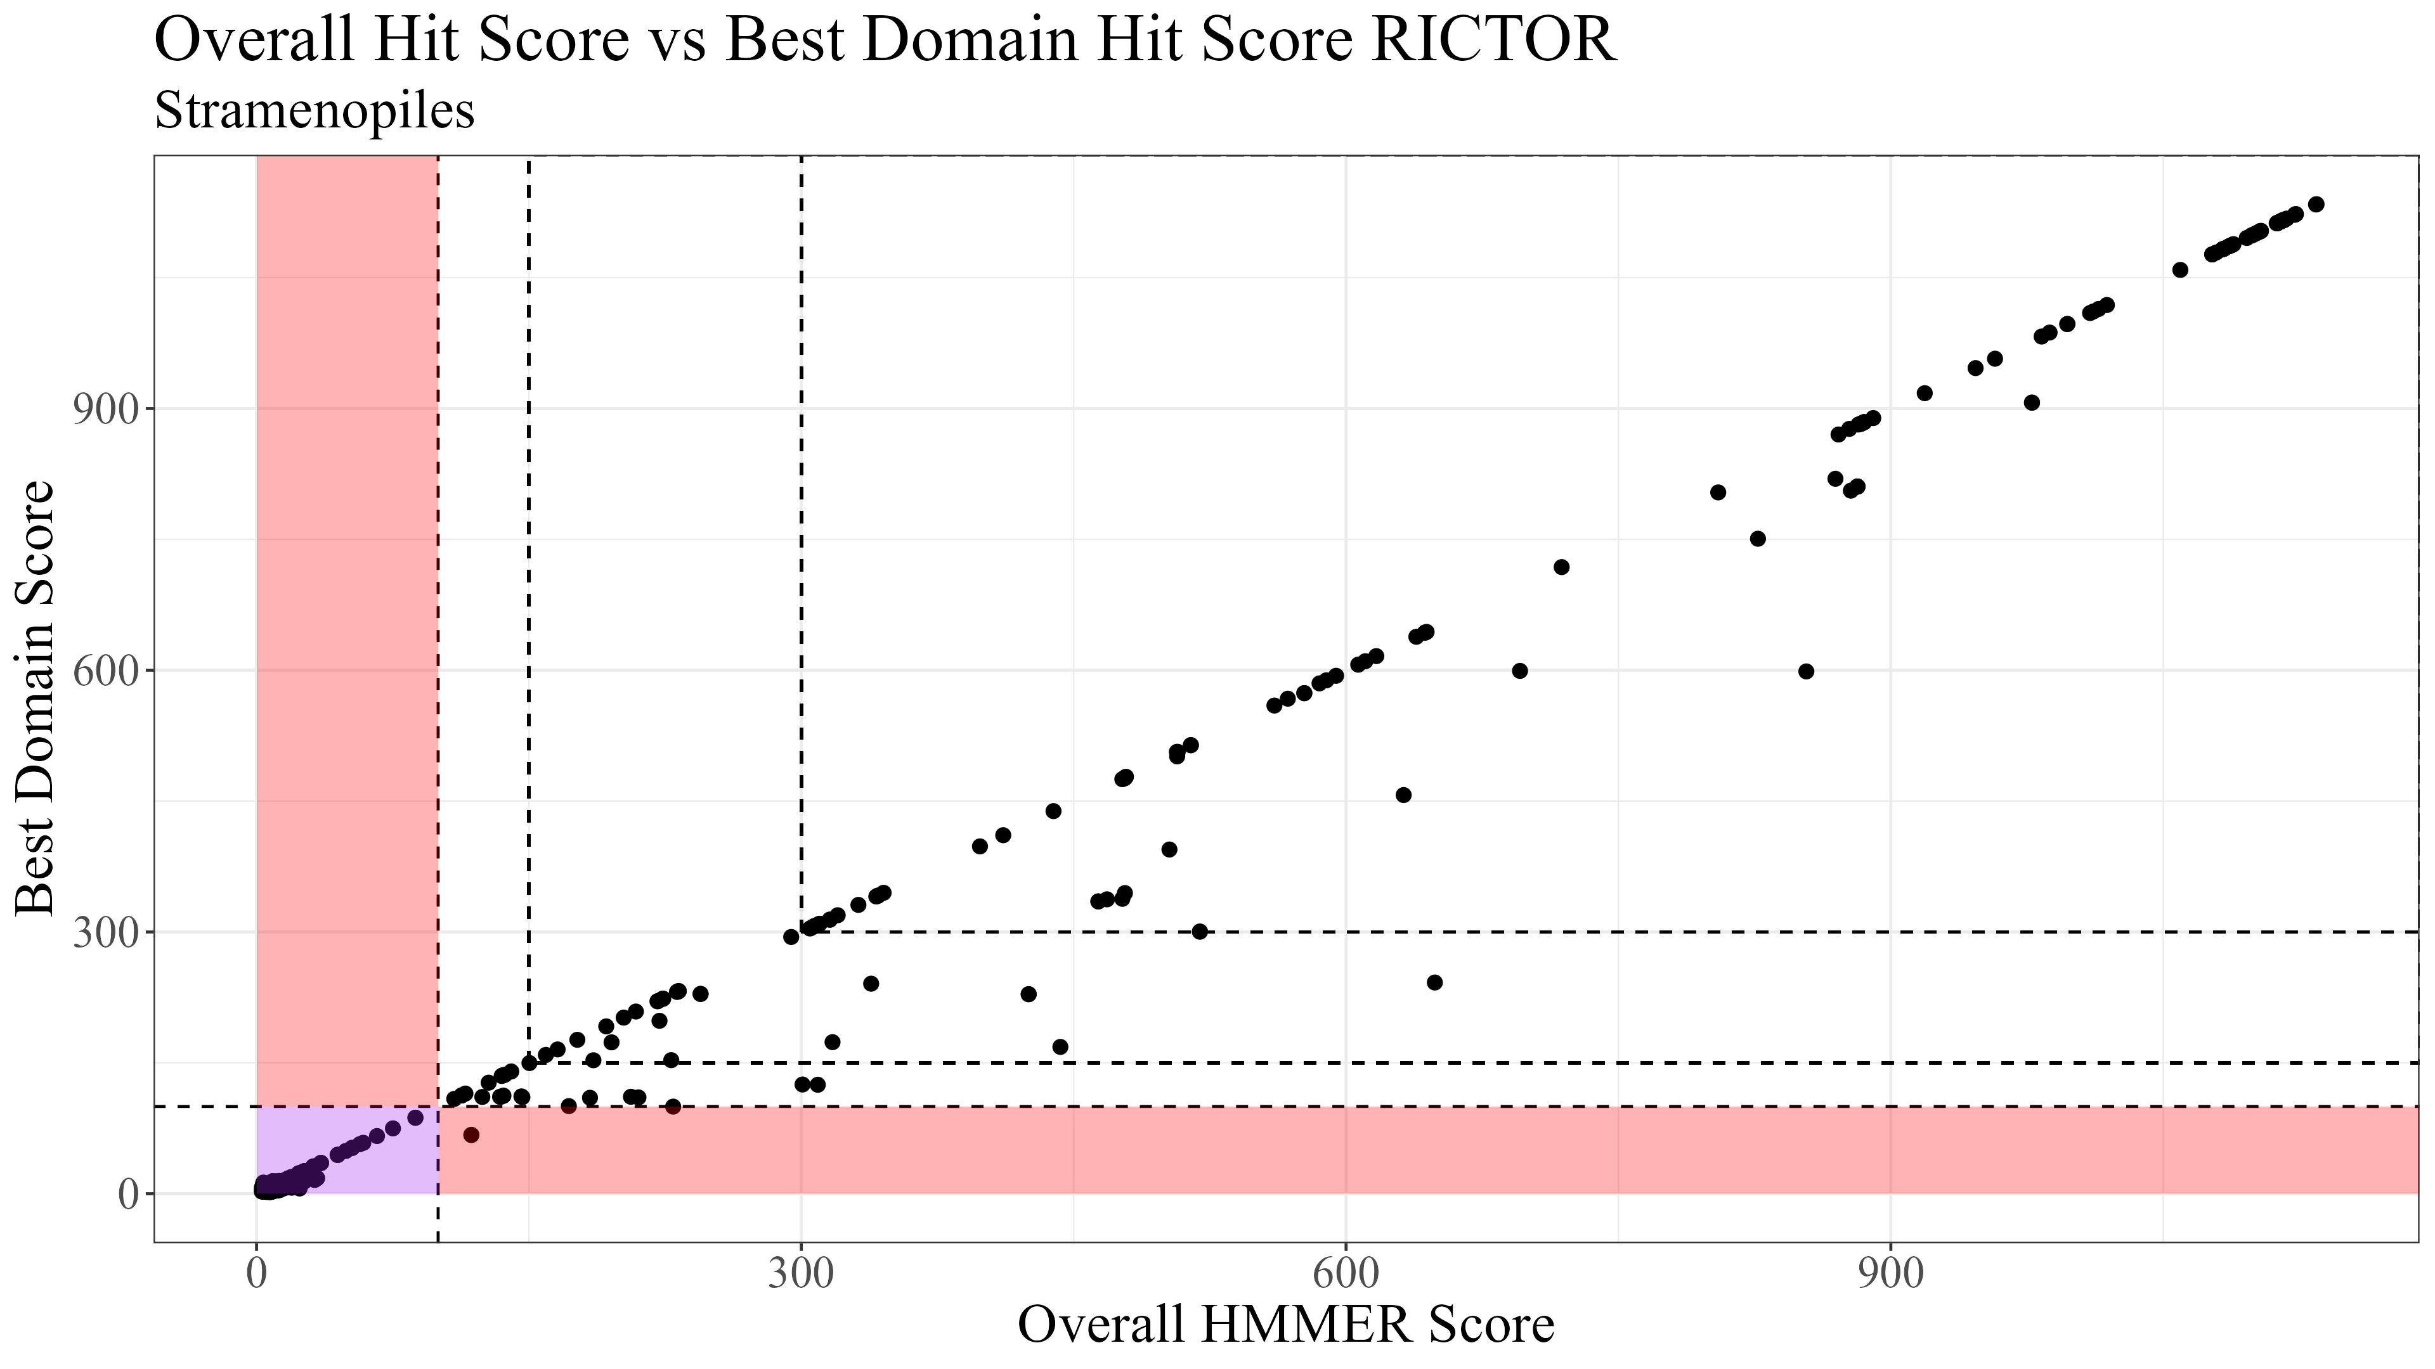
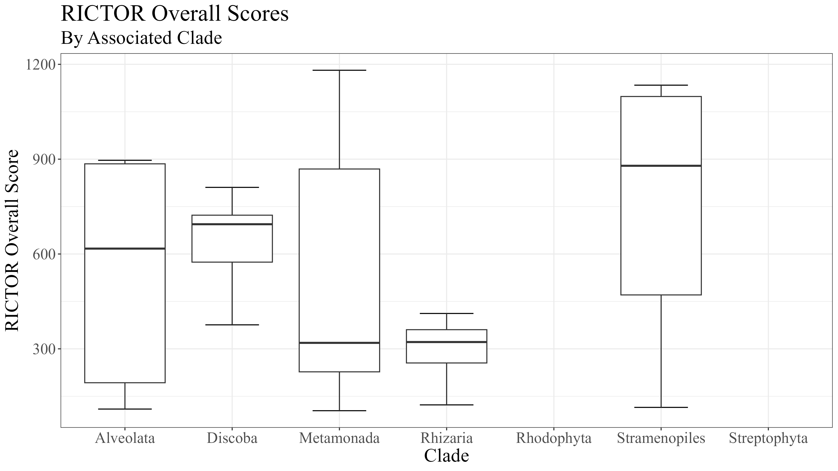
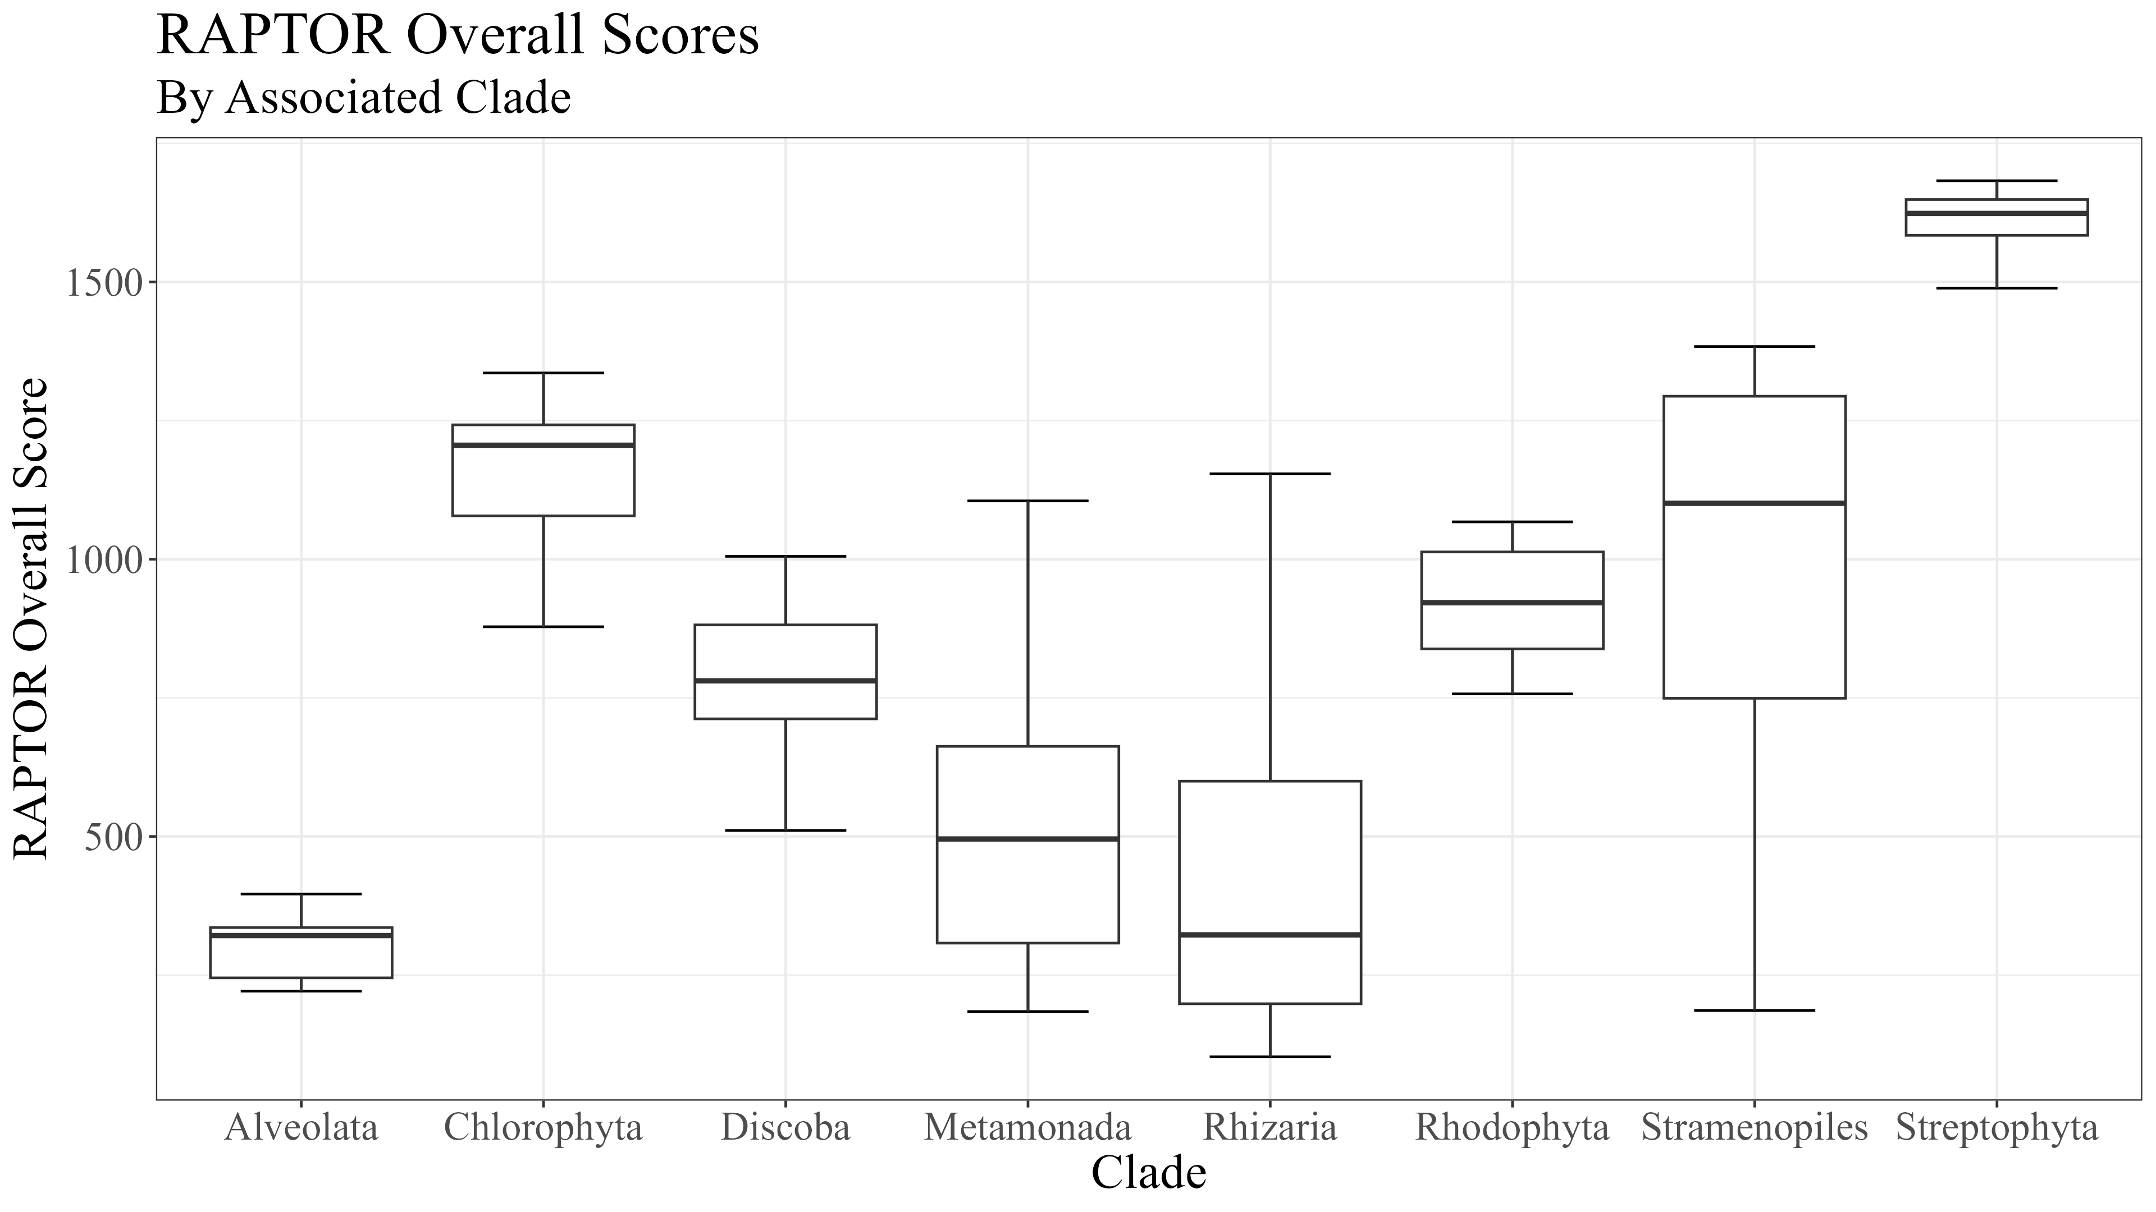
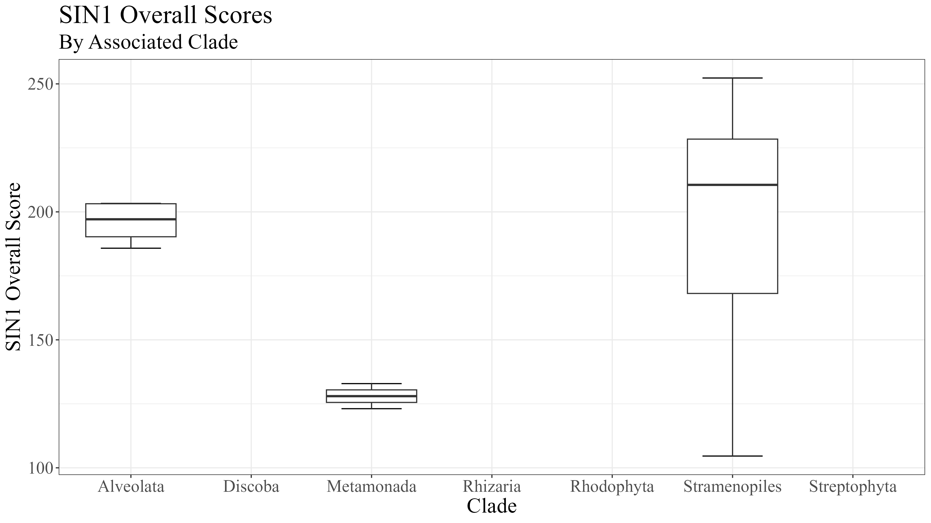
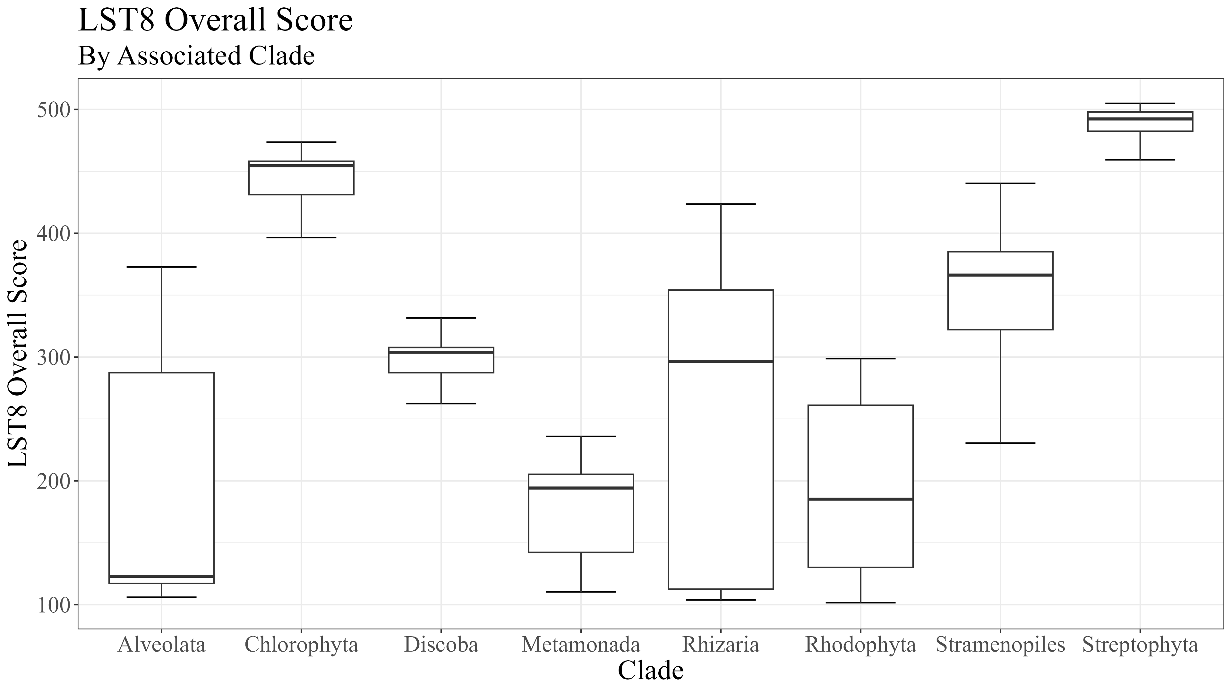
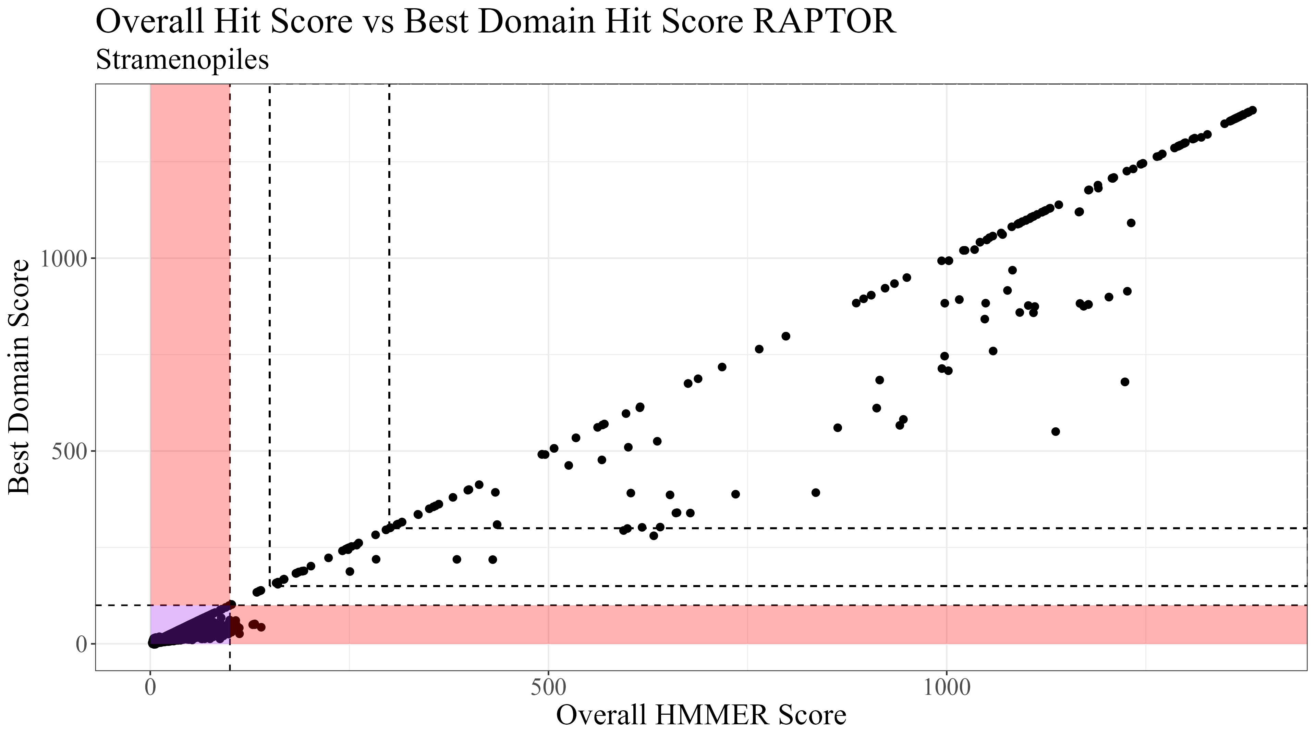
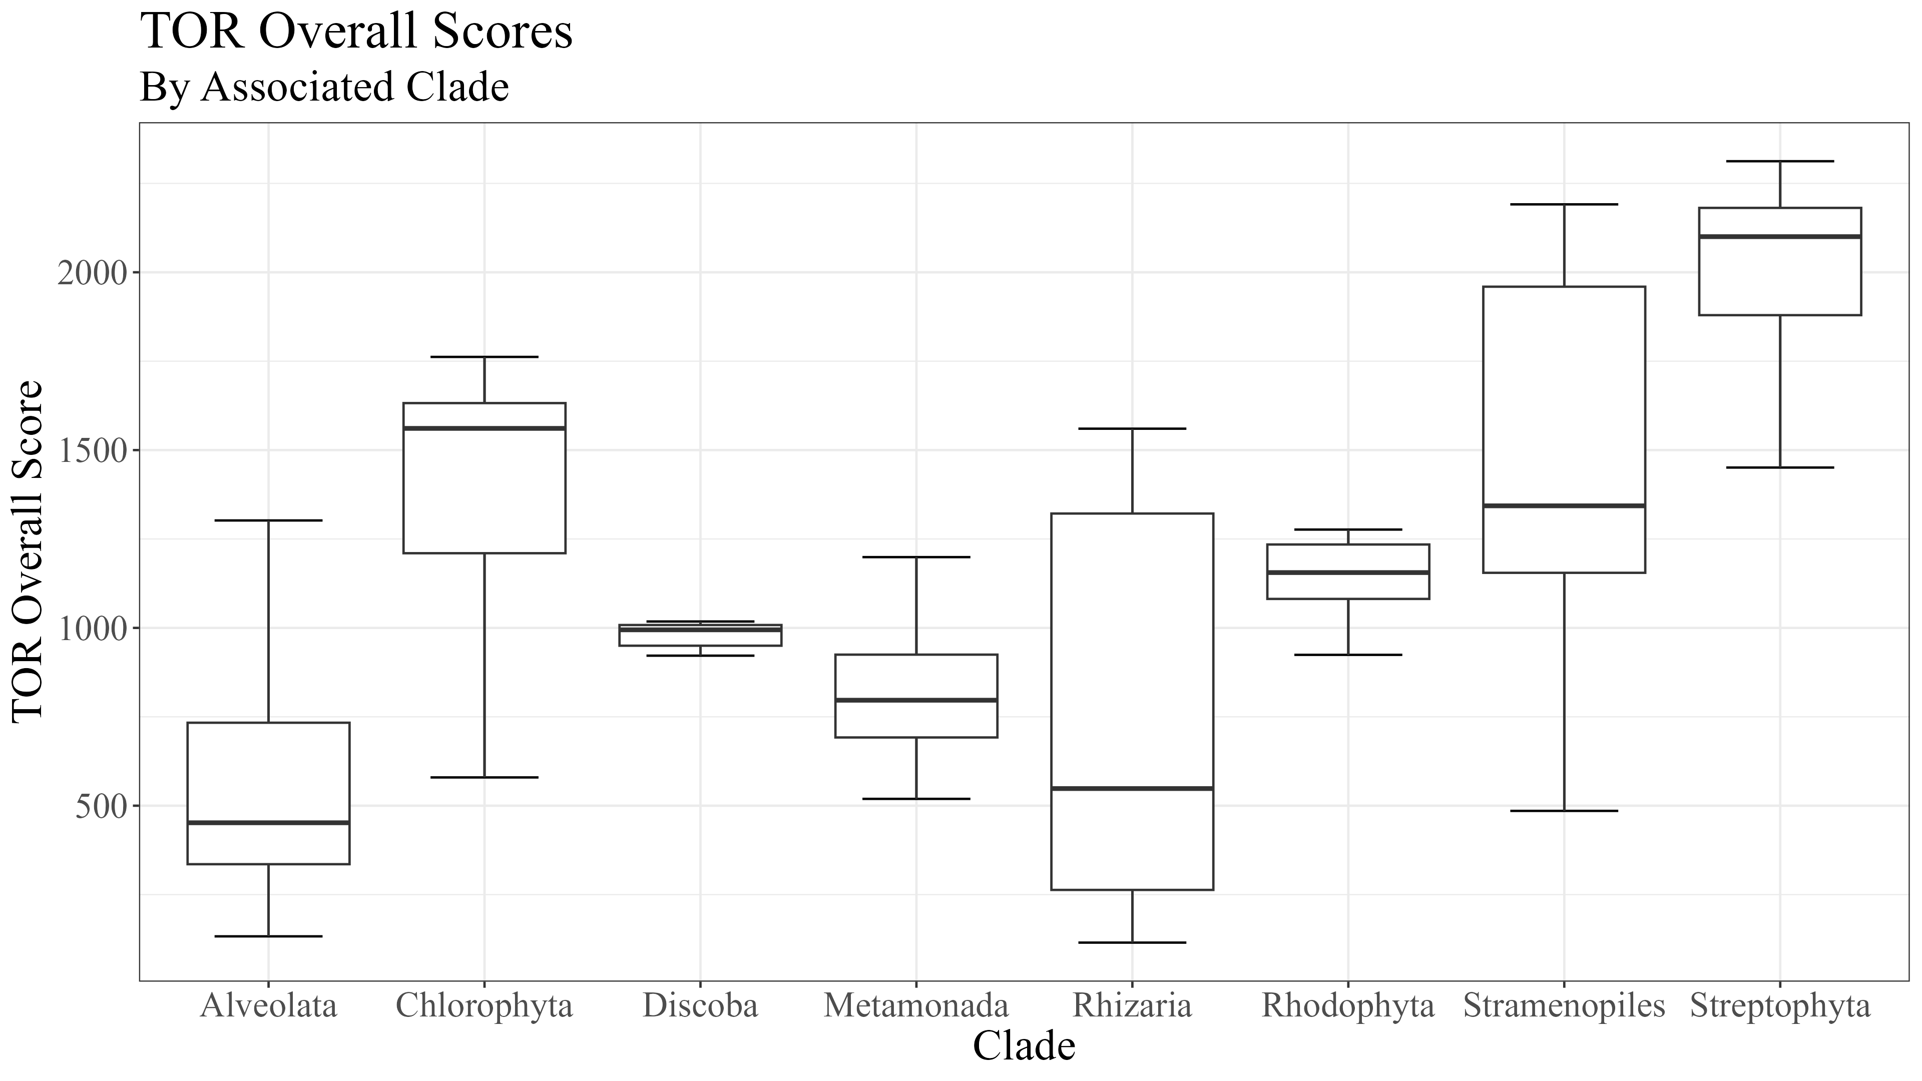
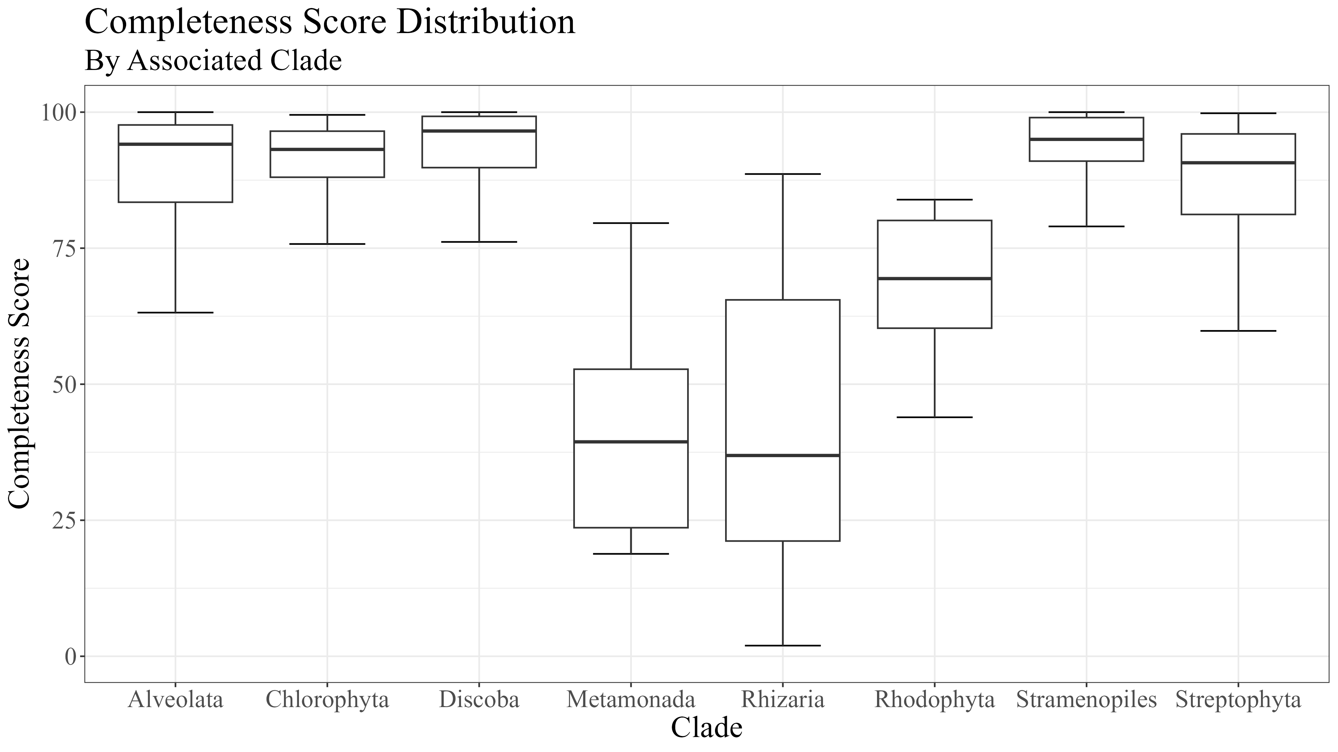
Supplemental 1
Notes:
Supplemental

Slide 8




Supplemental 2
RICTOR
RAPTOR
N
N
RICTORN
RAPTORN
Reference
Reference
High
RICTORM
ARM
High
Medium
RasGEF
HEAT
Low
Medium
Dom5
ARM
Reference
Reference
RICTOR
Phosphor
WD-40
High
High
Medium
Medium
Low
C
C
Notes:
Supplemental

Slide 9
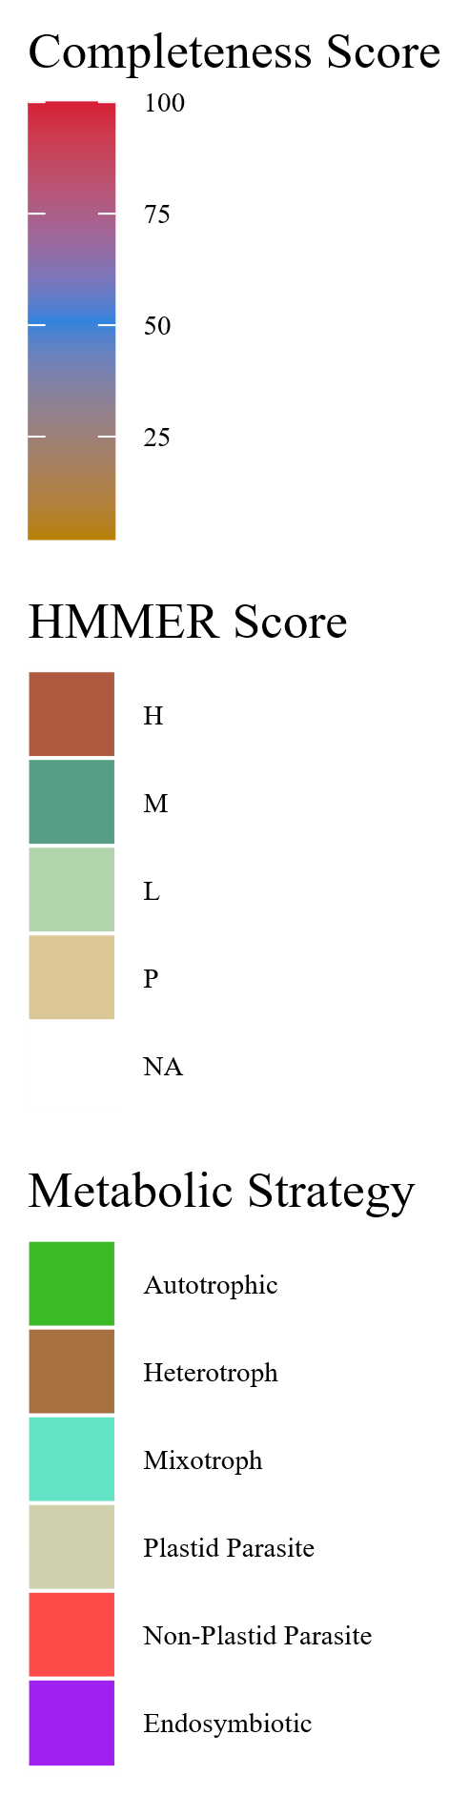
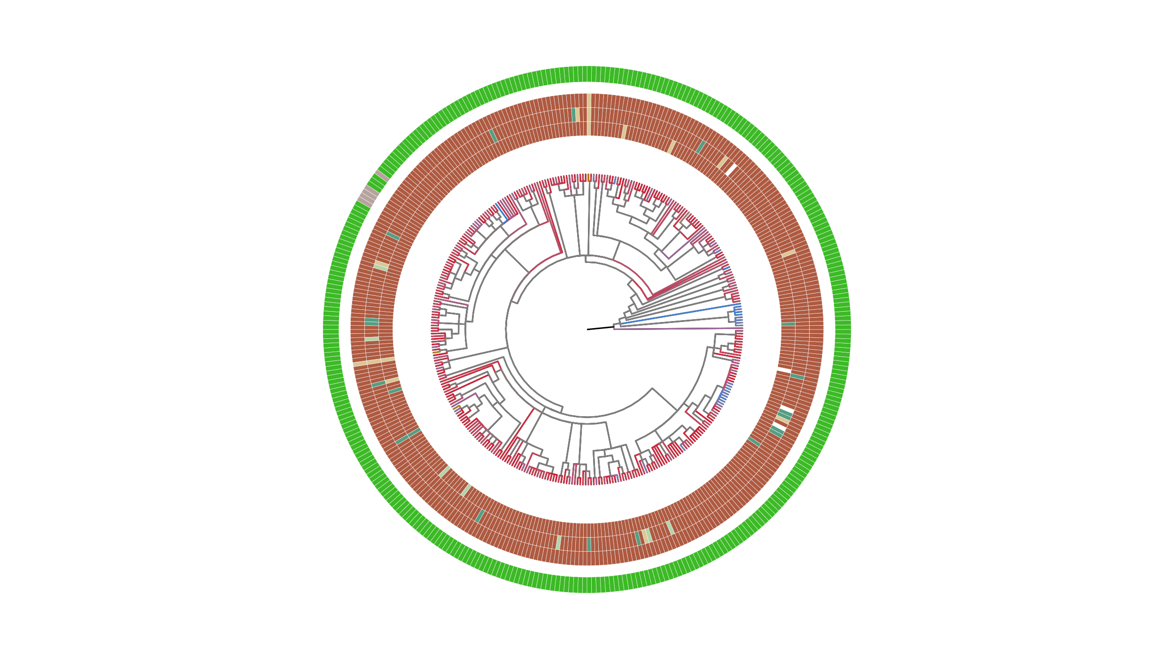
Supplemental 3
SIN1
RICTOR
RAPTOR
LST8
TOR
Chondrus crispus
Gracilaria domingensis
Gracilariopsis chorda
Cyanidium caldarium
Cyanidioschyzon merolae strain 10D
Streptophyta
Rhodophyta
Cyanidiococcus yangmingshanensis
Porphyra umbilicalis
Pyropia yezoensis
Pyropia vietnamensis
Porphyridium purpureum
Galdieria partita
Galdieria sulphuraria
Galdieria yellowstonensis
Rhodosorus marinus
Dunaliella salina
Chlamydomonas reinhardtii
Chlamydomonas incerta
Chlamydomonas eustigma
Chlamydomonas sp. UWO 241
Chlamydomonas schloesseri
Chloromonas remiasii
Sanguina aurantia
Microglena sp. YARC
Volvox carteri f. nagariensis
Volvox africanus
Volvox reticuliferus
Gonium pectorale
Pleodorina starrii
Haematococcus lacustris
Edaphochlamys debaryana
Astrephomene gubernaculifera
Tetrabaena socialis
Limnomonas spitsbergensis
Scenedesmus sp. NREL 46B-D3
Scenedesmus sp. PABB004
Tetradesmus obliquus
Tetradesmus deserticola
Enallax costatus
Flechtneria rotunda
Desmodesmus armatus
Chromochloris zofingiensis
Monoraphidium minutum
Monoraphidium neglectum
Raphidocelis subcapitata
Chlorella sorokiniana
Chlorella vulgaris
Chlorella variabilis
Chlorella desiccata (nom. nud.)
Chlorella sp. A99
Chlorella ohadii
Auxenochlorella protothecoides
Prototheca wickerhamii
Chlorophyta
Micractinium conductrix
Apatococcus lobatus
Apatococcus fuscideae
Helicosporidium sp. ATCC 50920
Chlorellaceae sp.
Symbiochloris reticulata
Symbiochloris irregularis
[Myrmecia] bisecta
Asterochloris sp. Cgr/DA1pho
Trebouxia sp. A1-2
Trebouxia sp. C0004
Trebouxia sp. C0005
Trebouxia sp. C0006
Trebouxia sp. C0009 RCD-2024
Trebouxia sp. C0010 RCD-2024
Coccomyxa subellipsoidea C-169
Coccomyxa viridis
Coccomyxa elongata
Coccomyxa sp. Obi
Elliptochloris bilobata
Botryococcus braunii Showa
Picochlorum sp. SENEW3
Picochlorum sp. soloecismus
Picochlorum sp. BH-2019
Picochlorum sp. BPE23
Pedinomonas minor
Pedinophyceae sp. YPF-701
Tetraselmis striata
Micromonas commoda
Micromonas pusilla CCMP1545
Bathycoccus prasinos RCC1105
Ostreococcus tauri
Ostreococcus lucimarinus CCE9901
Pycnococcus provasolii
Ostreobium quekettii
Caulerpa lentillifera
Bryopsis sp. KO-2023
Ulva mutabilis

Slide 10
Rhodophyta
Archaeplastida
Chlorophyta
TORC1
TORC1
Streptophyta
TORC1 & TORC2
Stramenopiles
LECA
SAR
TORC1
Alveolata
TORC1 & TORC2
TORC2
Rhizaria
TORC1 & TORC2
Excavates
Discoba
TORC1 & TORC2
Metamonada

Slide 11
Rhodophyta
Archaeplastida
Chlorophyta
TORC1
TORC1
Streptophyta
TORC1 & TORC2
Stramenopiles
LECA
SAR
TORC1
Alveolata
TORC1 & TORC2
TORC2
Rhizaria
Discoba
TORC1 & TORC2
Excavates
TORC1 & TORC2
Metamonada

Slide 12
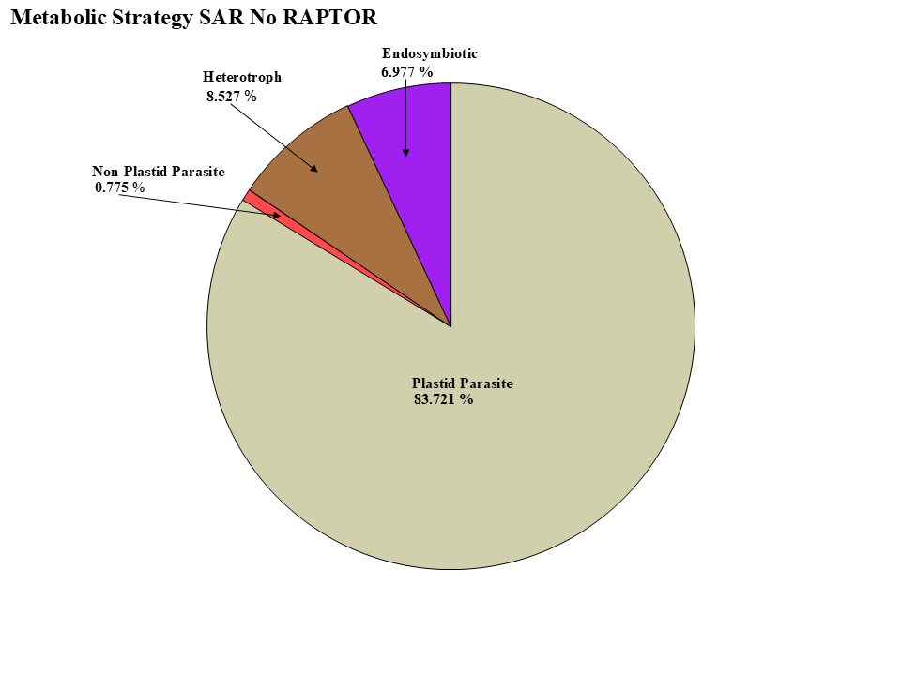
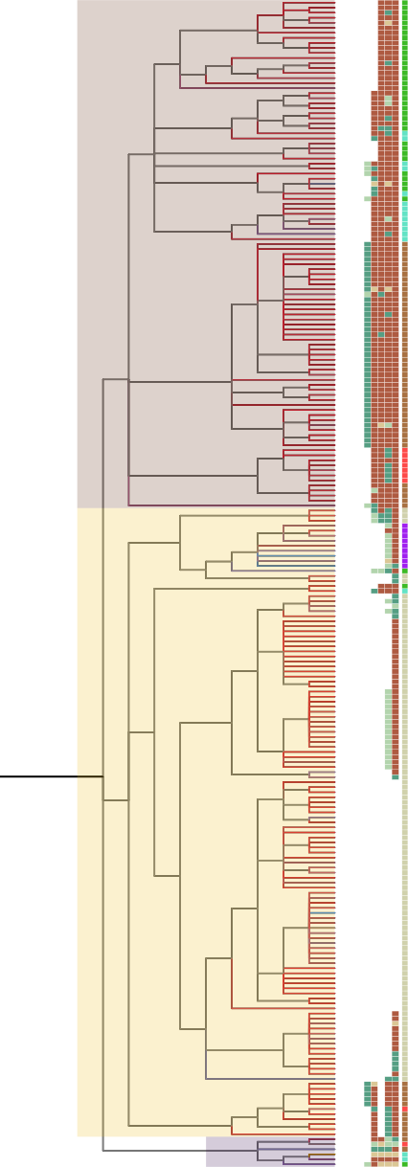
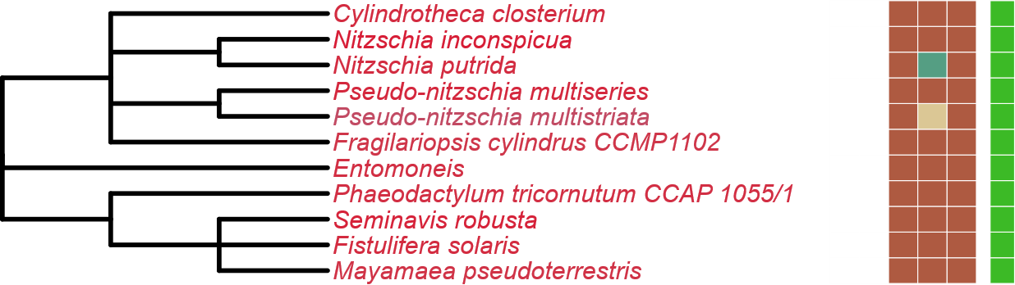
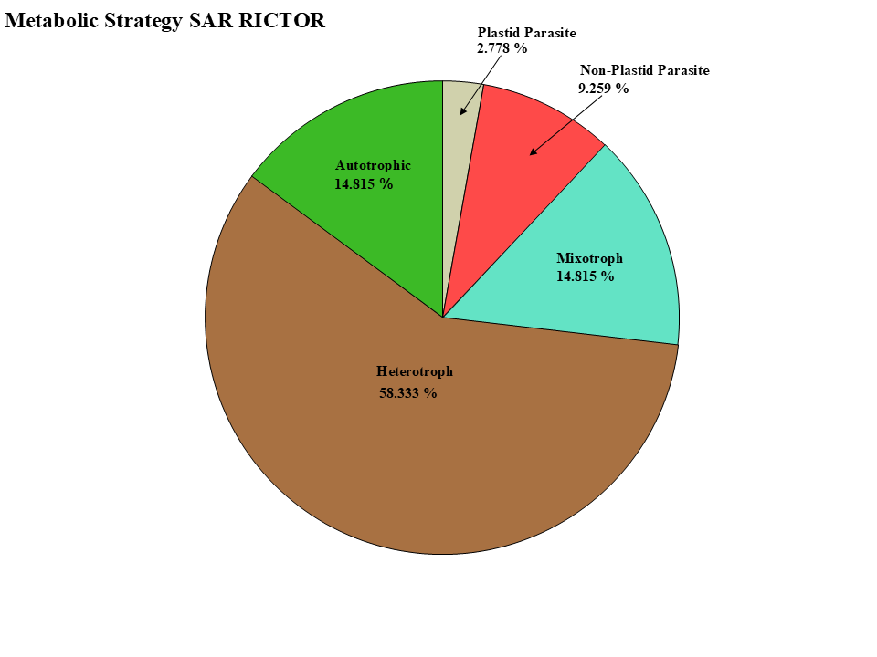
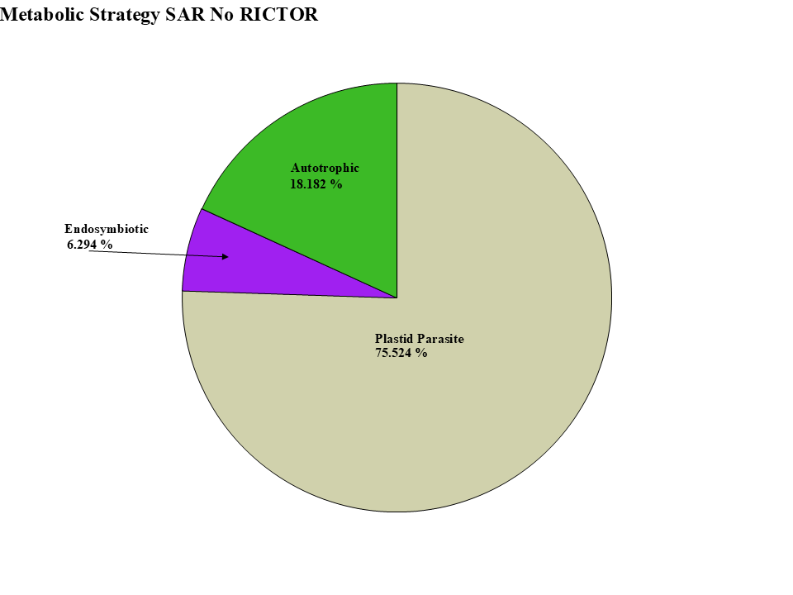
Figure 5
LST8
RICTOR
RAPTOR
SIN1
TOR
Stramenopiles
Alveolata
Rhizaria

Slide 13
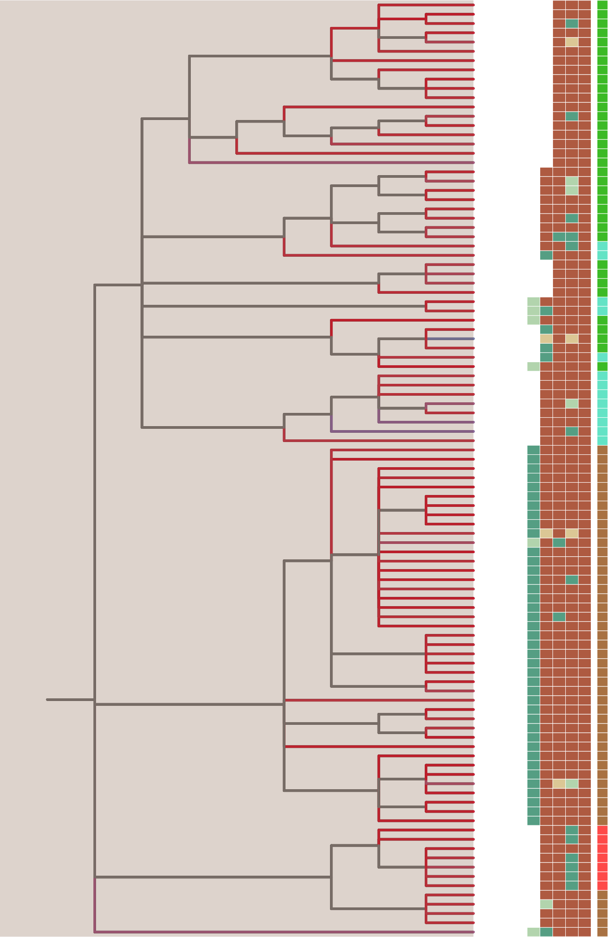
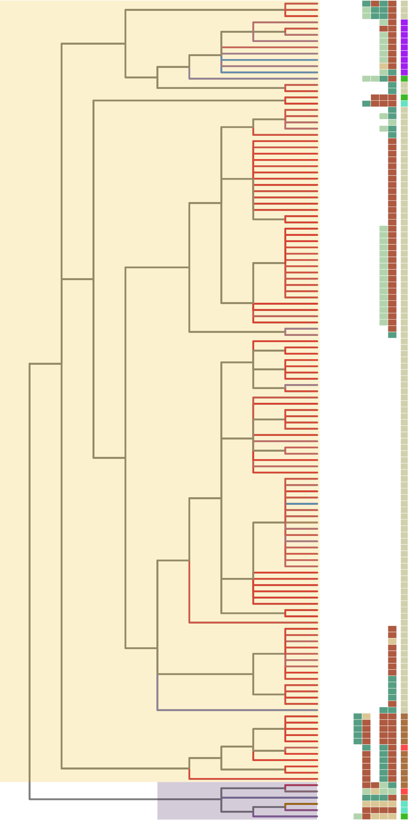



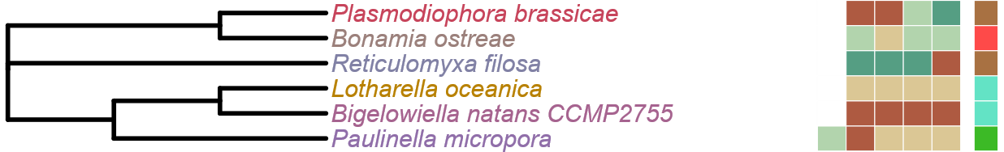
Figure 5
LST8
RICTOR
RAPTOR
Alveolata
Stramenopiles
SIN1
TOR
LST8
RICTOR
RAPTOR
SIN1
TOR
Rhizaria

Slide 14
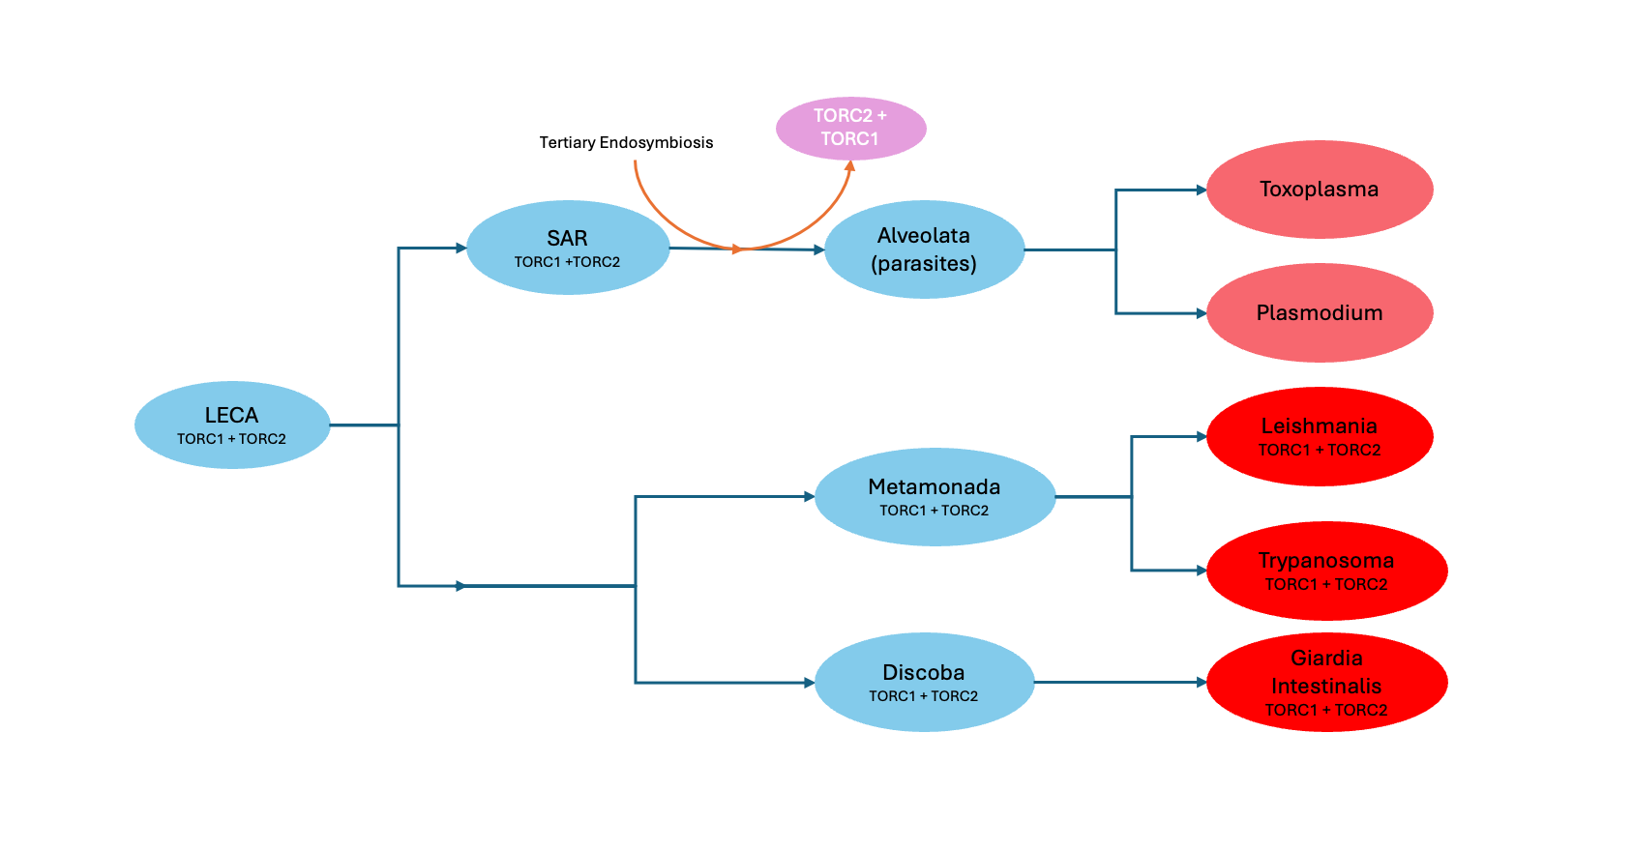

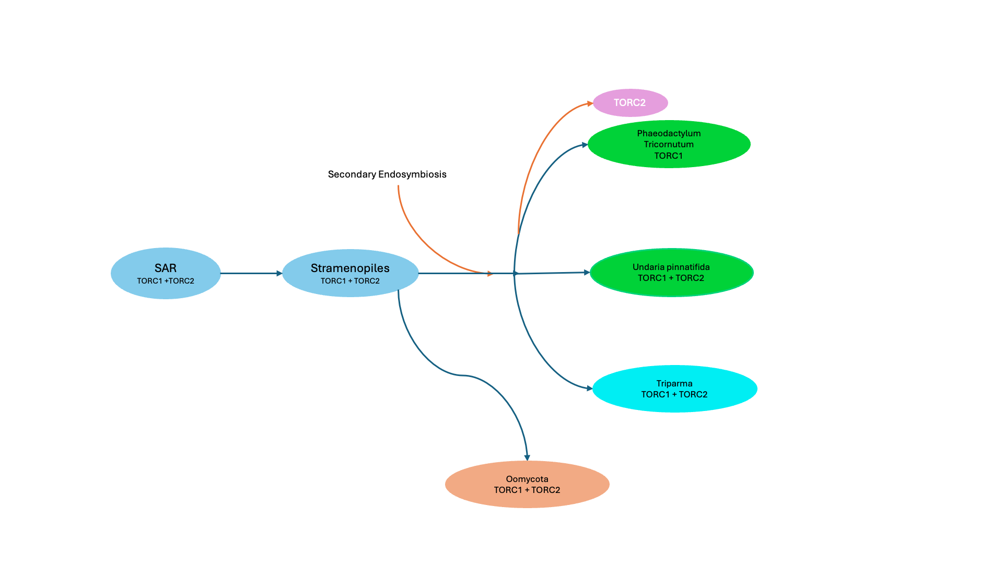

Slide 15
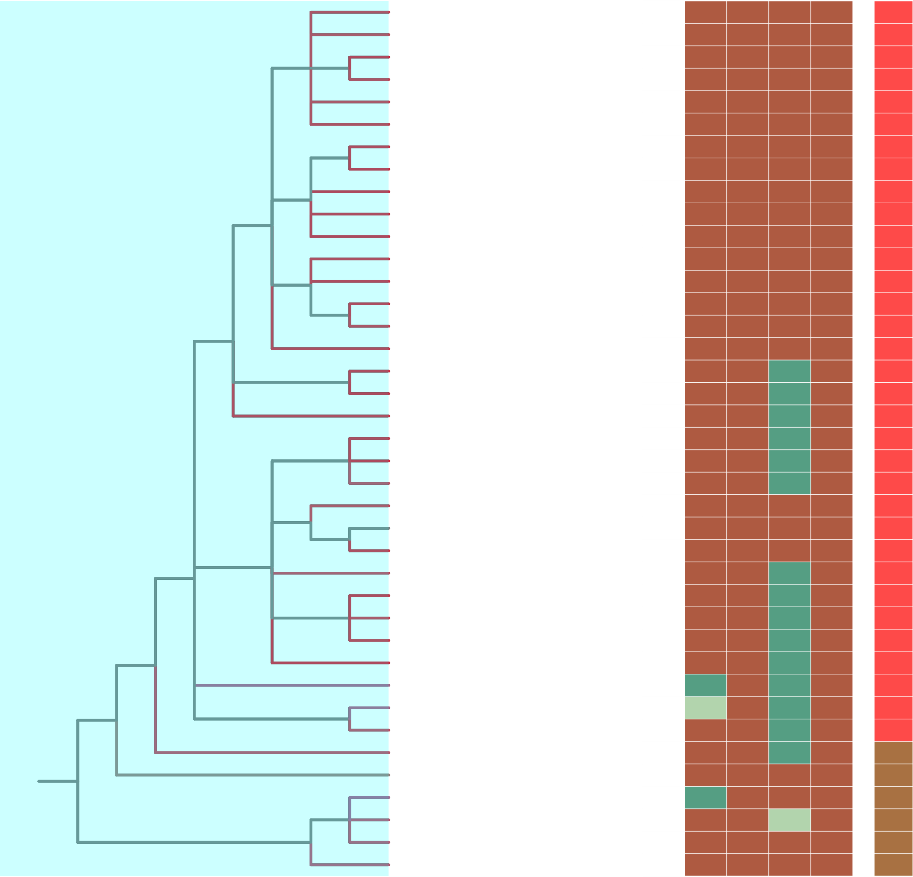
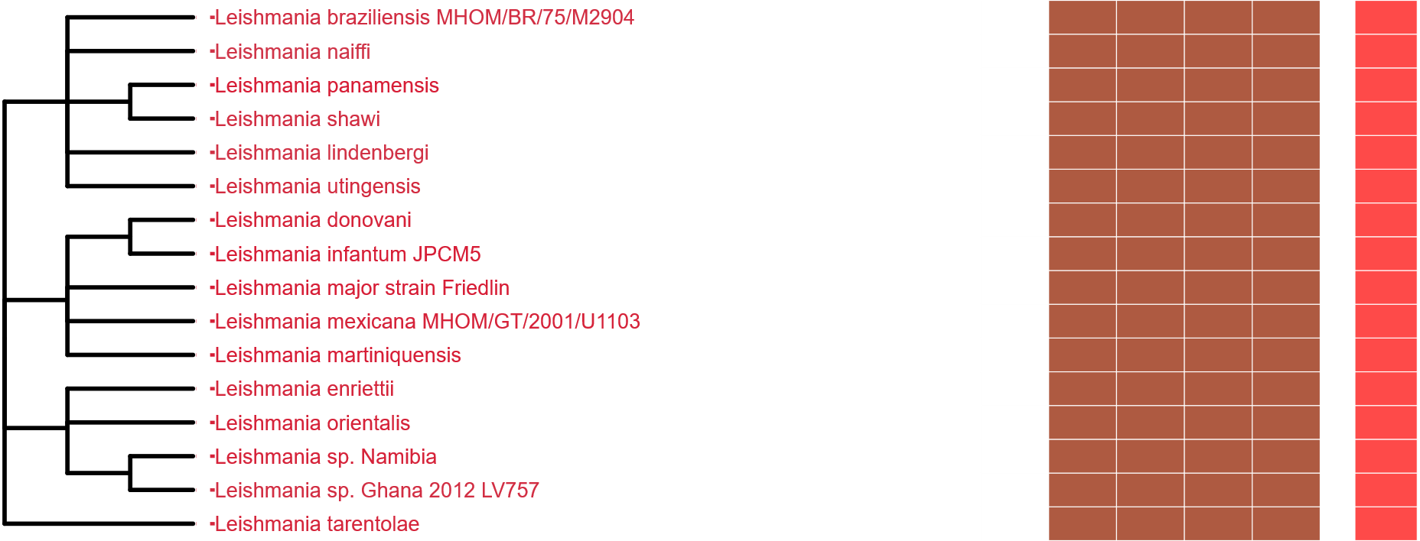
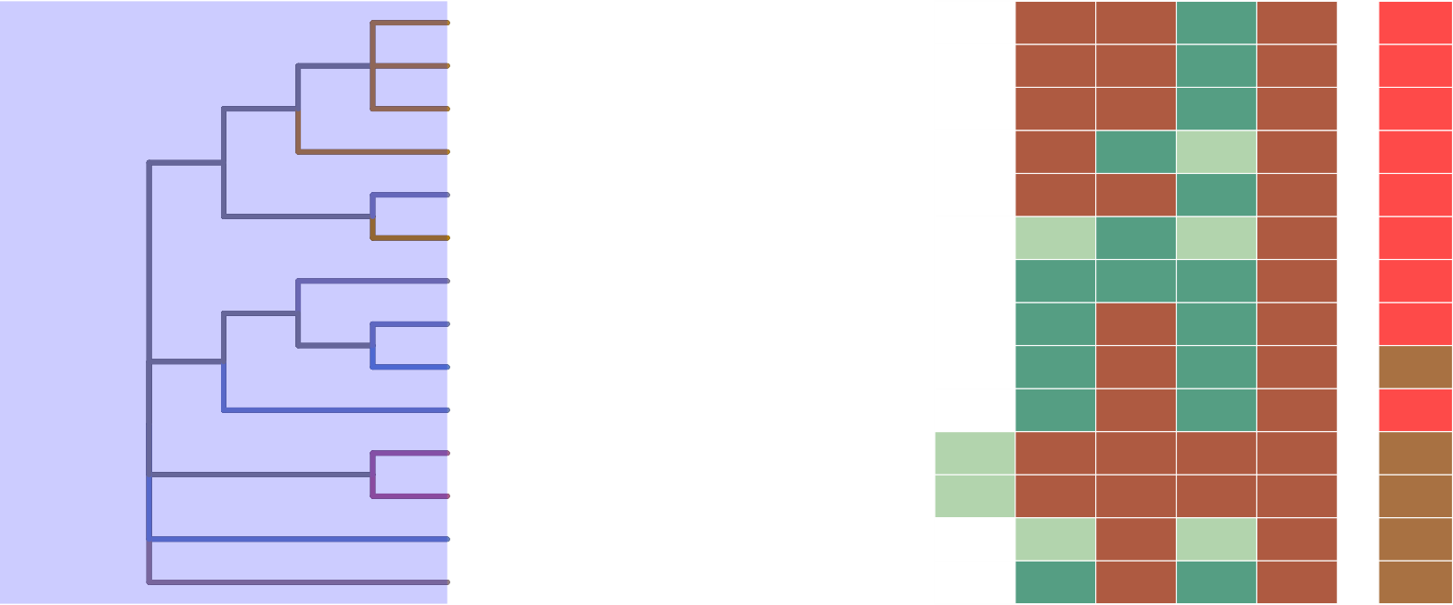
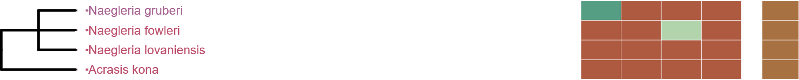
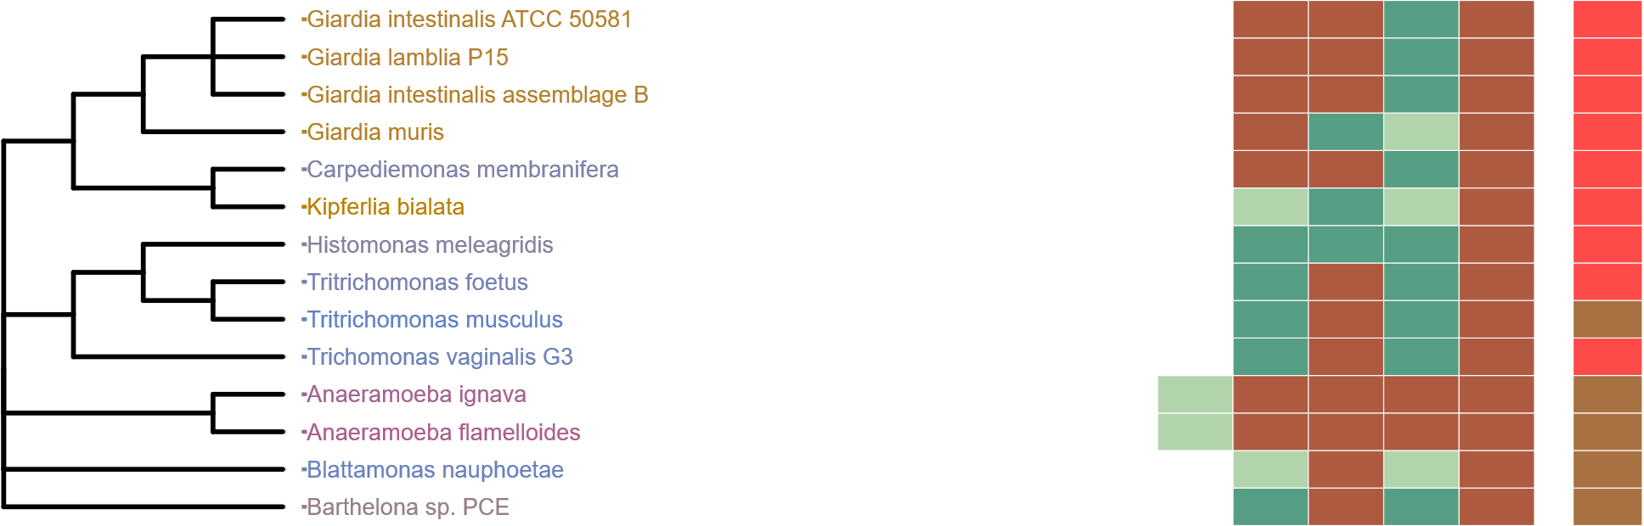
Figure 7
Metabolic Strategy
Metabolic Strategy
Metabolic Strategy
SIN1
RICTOR
RAPTOR
LST8
TOR
SIN1
RICTOR
RAPTOR
SIN1
LST8
RICTOR
RAPTOR
LST8
TOR
TOR
Discoba
Metamonada
Metabolic Strategy
SIN1
RICTOR
RAPTOR
LST8
TOR

Slide 16
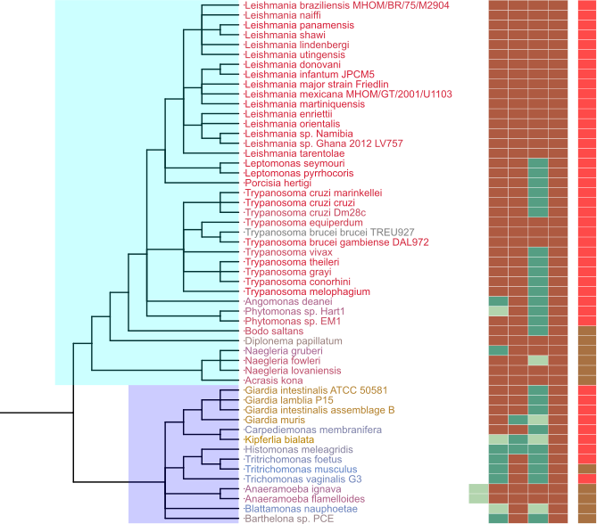
Figure 7
Metabolic Strategy
SIN1
RICTOR
RAPTOR
LST8
TOR
Discoba
TORC2
Archaeplastida
TORC1
LECA
TORC1
TORC2
Excavates
TORC1
TORC2
Discoba
TORC1
TORC2
Metamonada
Metamonada
TORC1
TORC2

Slide 17
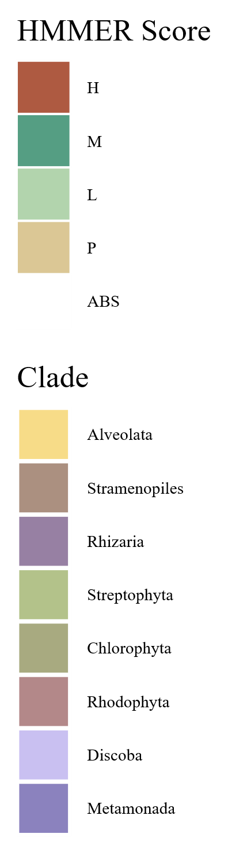
Rhodophyta
TORC2
TORC1
TORC2
Archaeplastida
Chlorophyta
TORC1
TORC1
TORC1
Streptophyta
TORC1
Stramenopila
LECA
TORC1
TORC2
SAR
TORC1
TORC2
TORC1
TORC2
TORC1
TORC2
Alveolata
TORC1
TORC2
TORC1
TORC2
Excavata
Discoba
Rhizaria
TORC1
TORC2
TORC1
TORC2
TORC1
TORC2
TORC1
TORC2
Metamonada
TORC1
TORC2
Notes:
This particular page is a sort of prototype for the last figure. No matter how we slice it though, the exact pathways are rather complicated and take up a lot of room

Slide 18
Figure 6
LECA
TORC1 +TORC2
Primary Endosymbiosis
TORC2
Archaeplastida
TORC1
Chlorophyta
TORC1
Streptophyta
TORC1
Rhodophyta
TORC1

Slide 19
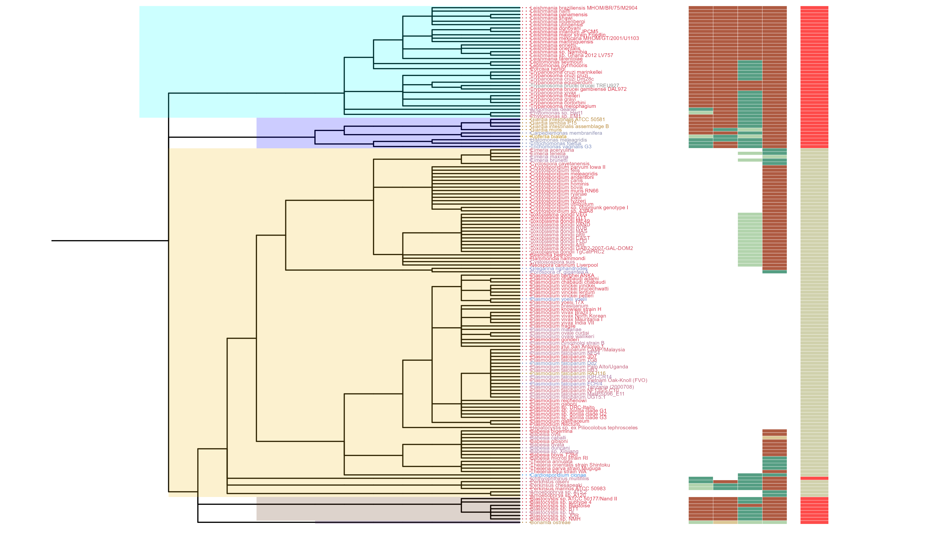
Figure 6
SIN1
RICTOR
RAPTOR
LST8
TOR
Discoba
Metamonada
Alveolata
Rhizaria
Stramenopiles

Slide 21
RICTOR
Color
LECA
Color
RAPTOR
Color
Archaeplastida
Color
Rhodophyta
TORC1
TORC2
Archaeplastida
Chlorophyta
TORC1
TORC1
Streptophyta
LECA
TORC1
TORC1
TORC2
Excavates,SAR,Opisthokonta,etc
TORC1
TORC2

Slide 22
ARCHIVED BELOW

Slide 23
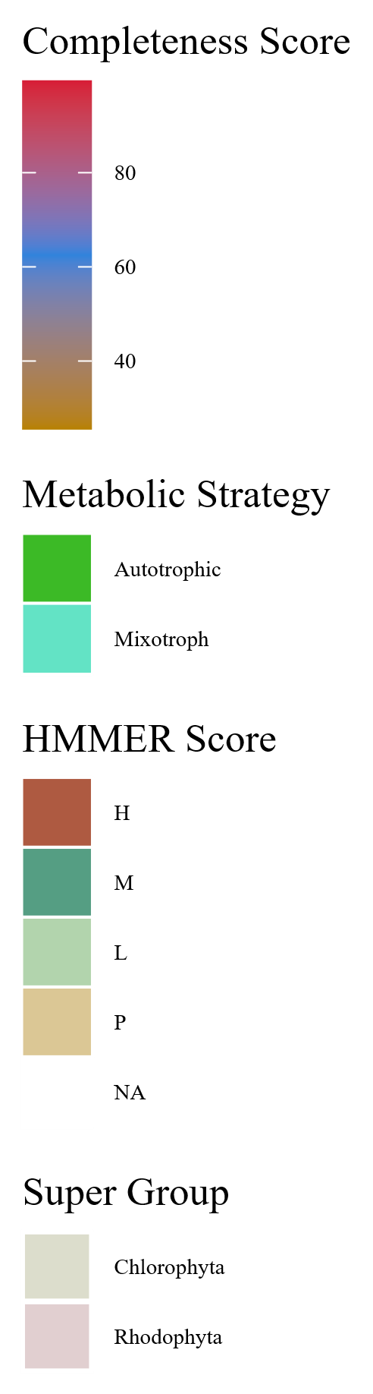
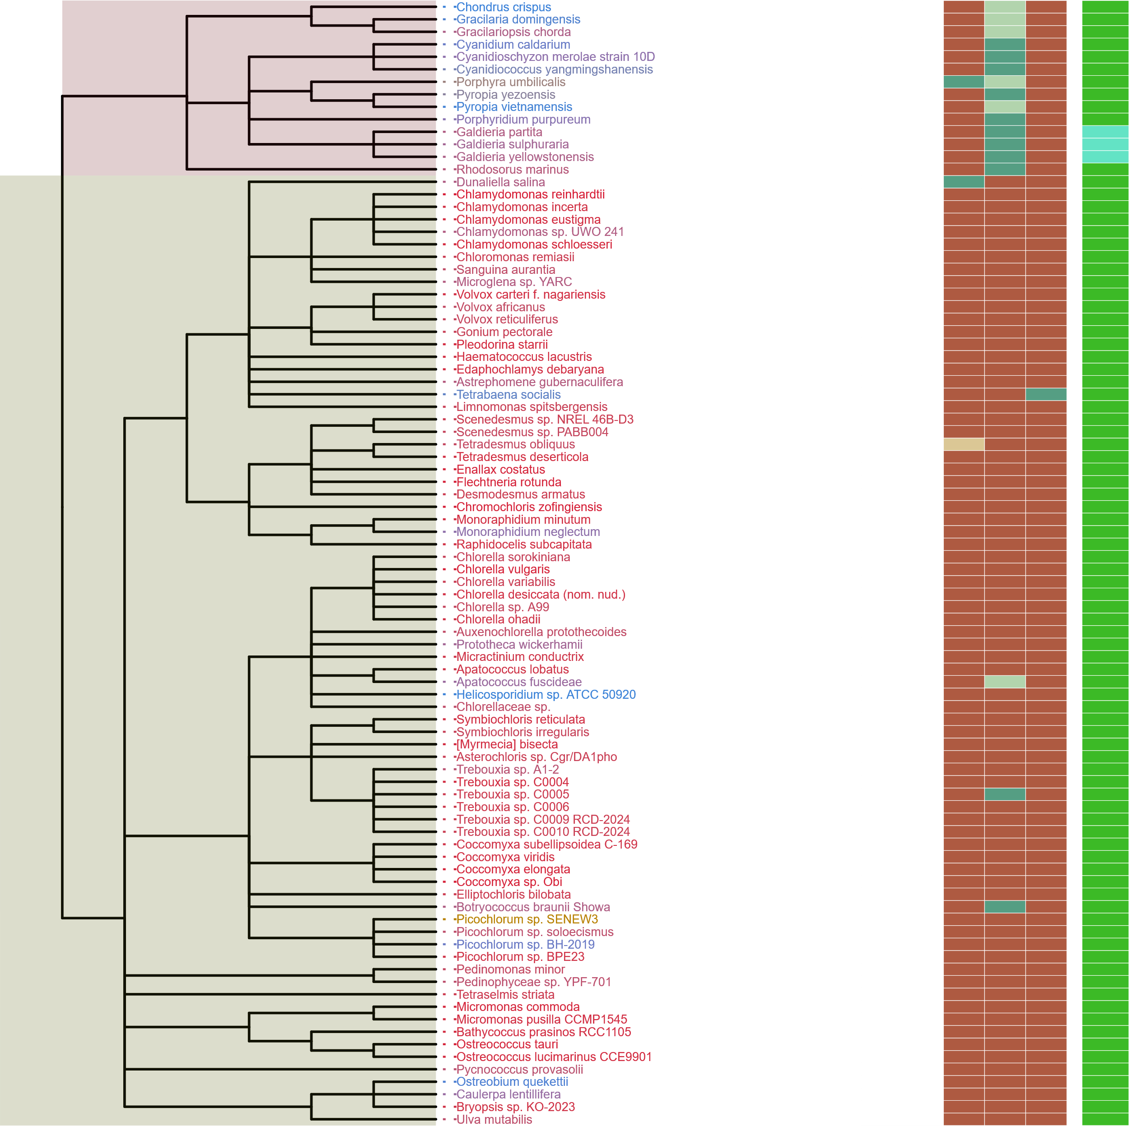
Streptophyta
Metabolic Strategy
SIN1
RICTOR
RAPTOR
LST8
TOR
Rhodophyta
Rhodophyta
TORC2
Chlorophyta
Archaeplastida
Chlorophyta
TORC1
Streptophyta
LECA
TORC1
TORC2
Excavates,SAR,Opisthokonta
TORC1
TORC2
Notes:
Supplemental Archaeplastida

Slide 24
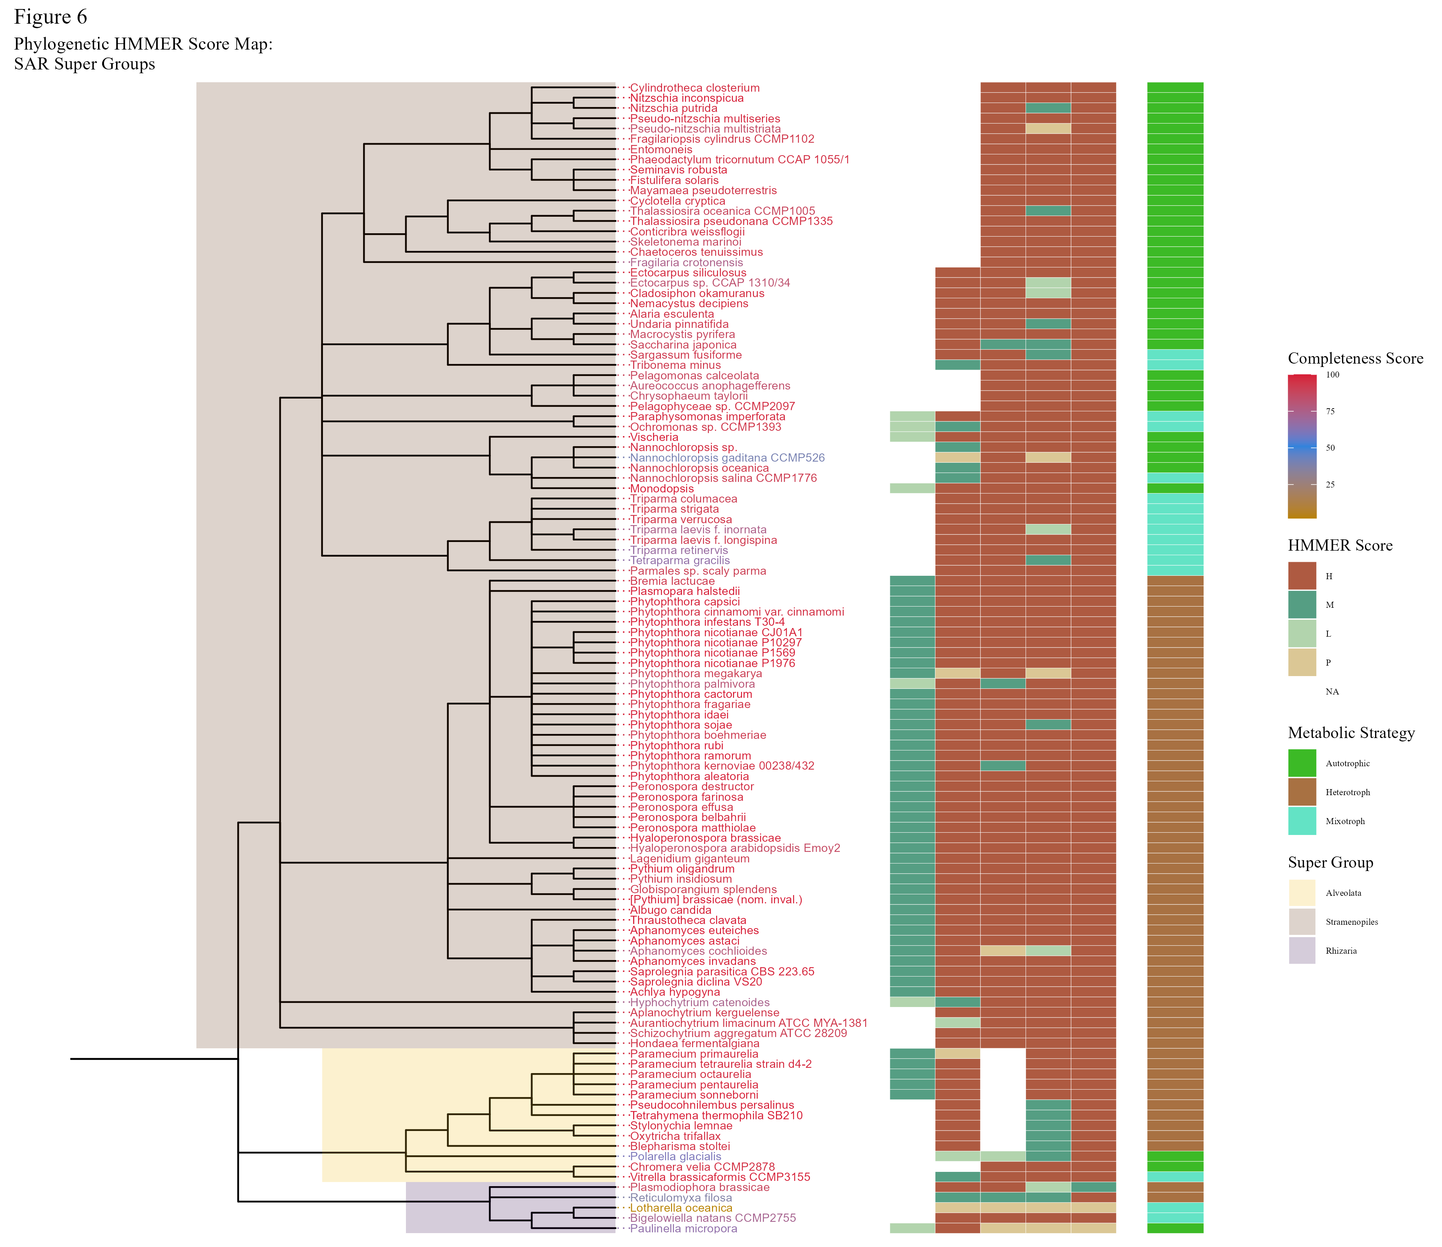
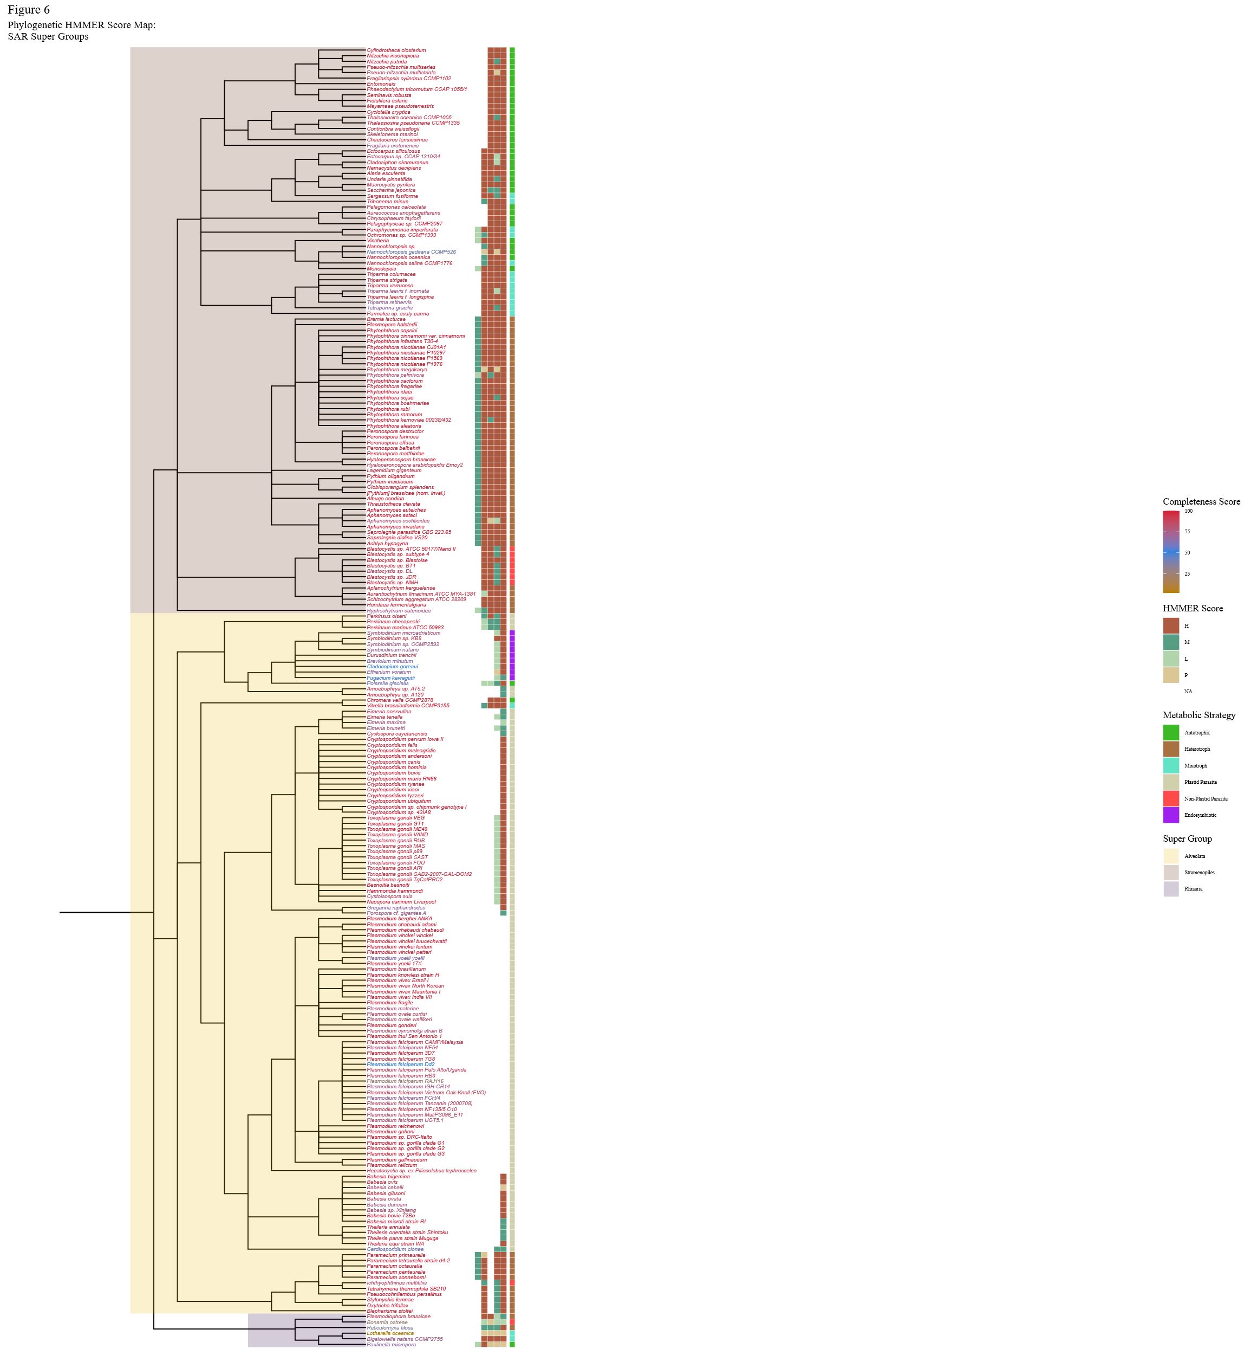
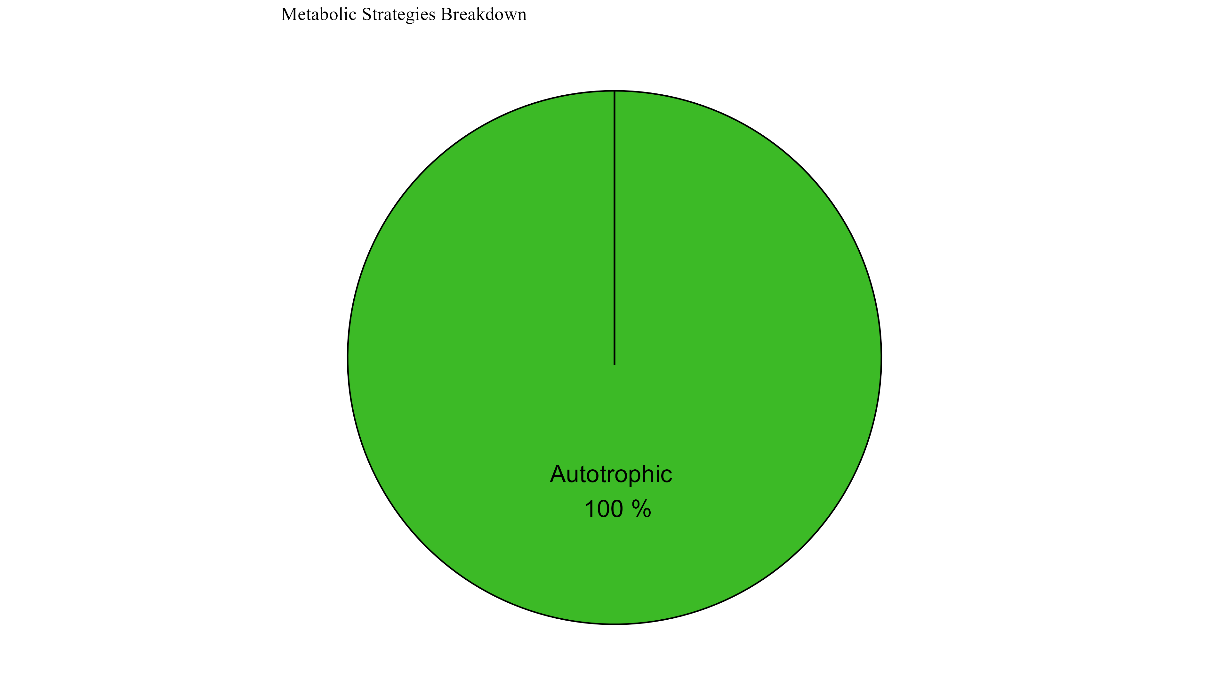
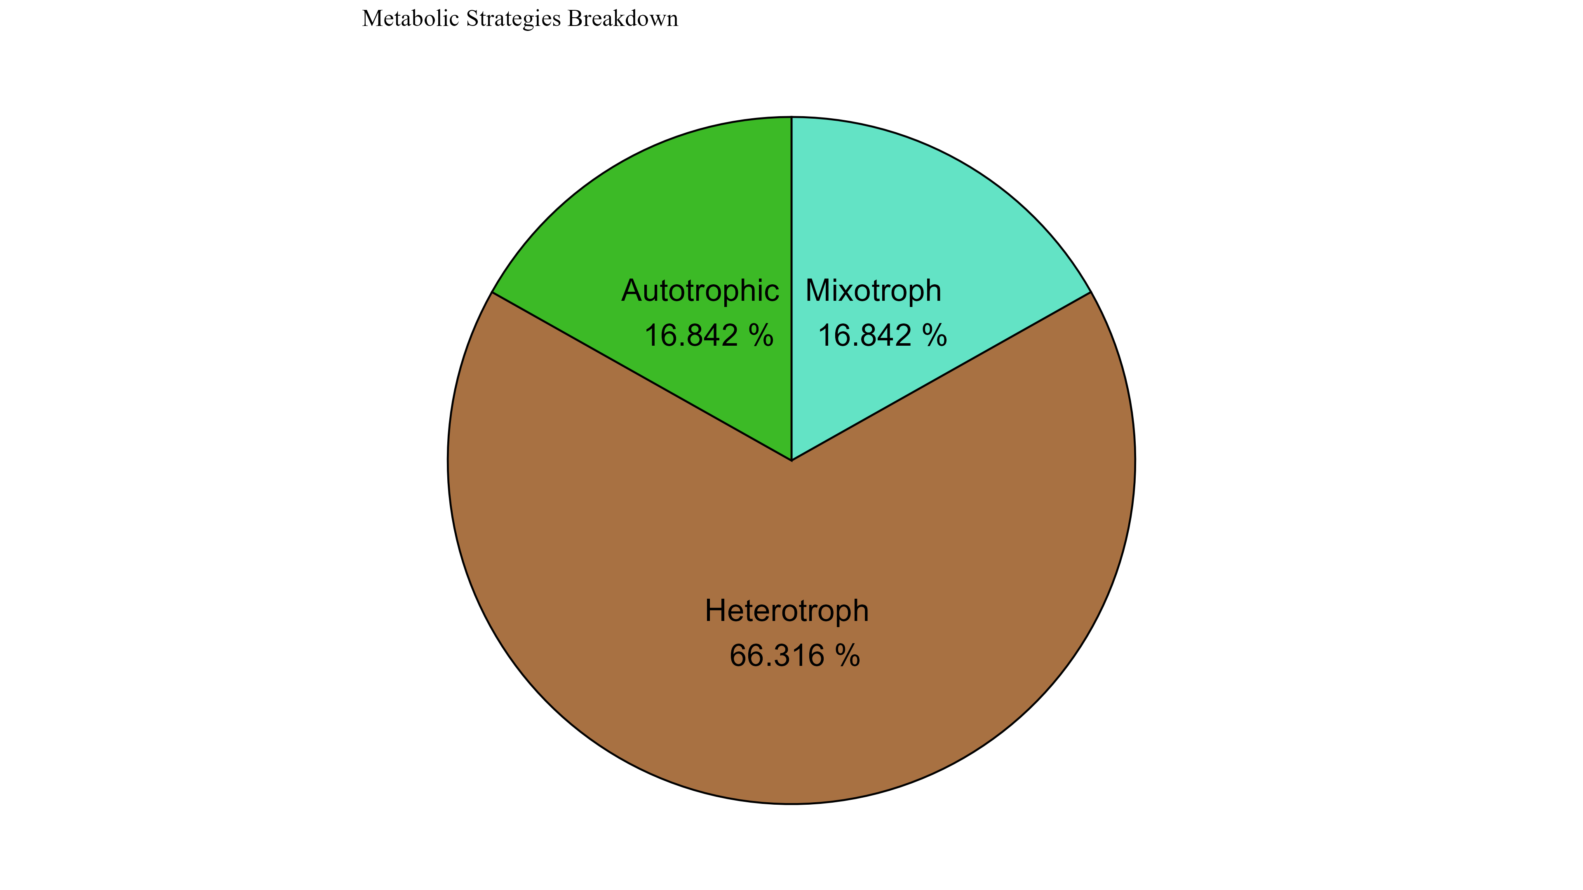
Notes:
Supplemental Possible

Slide 25
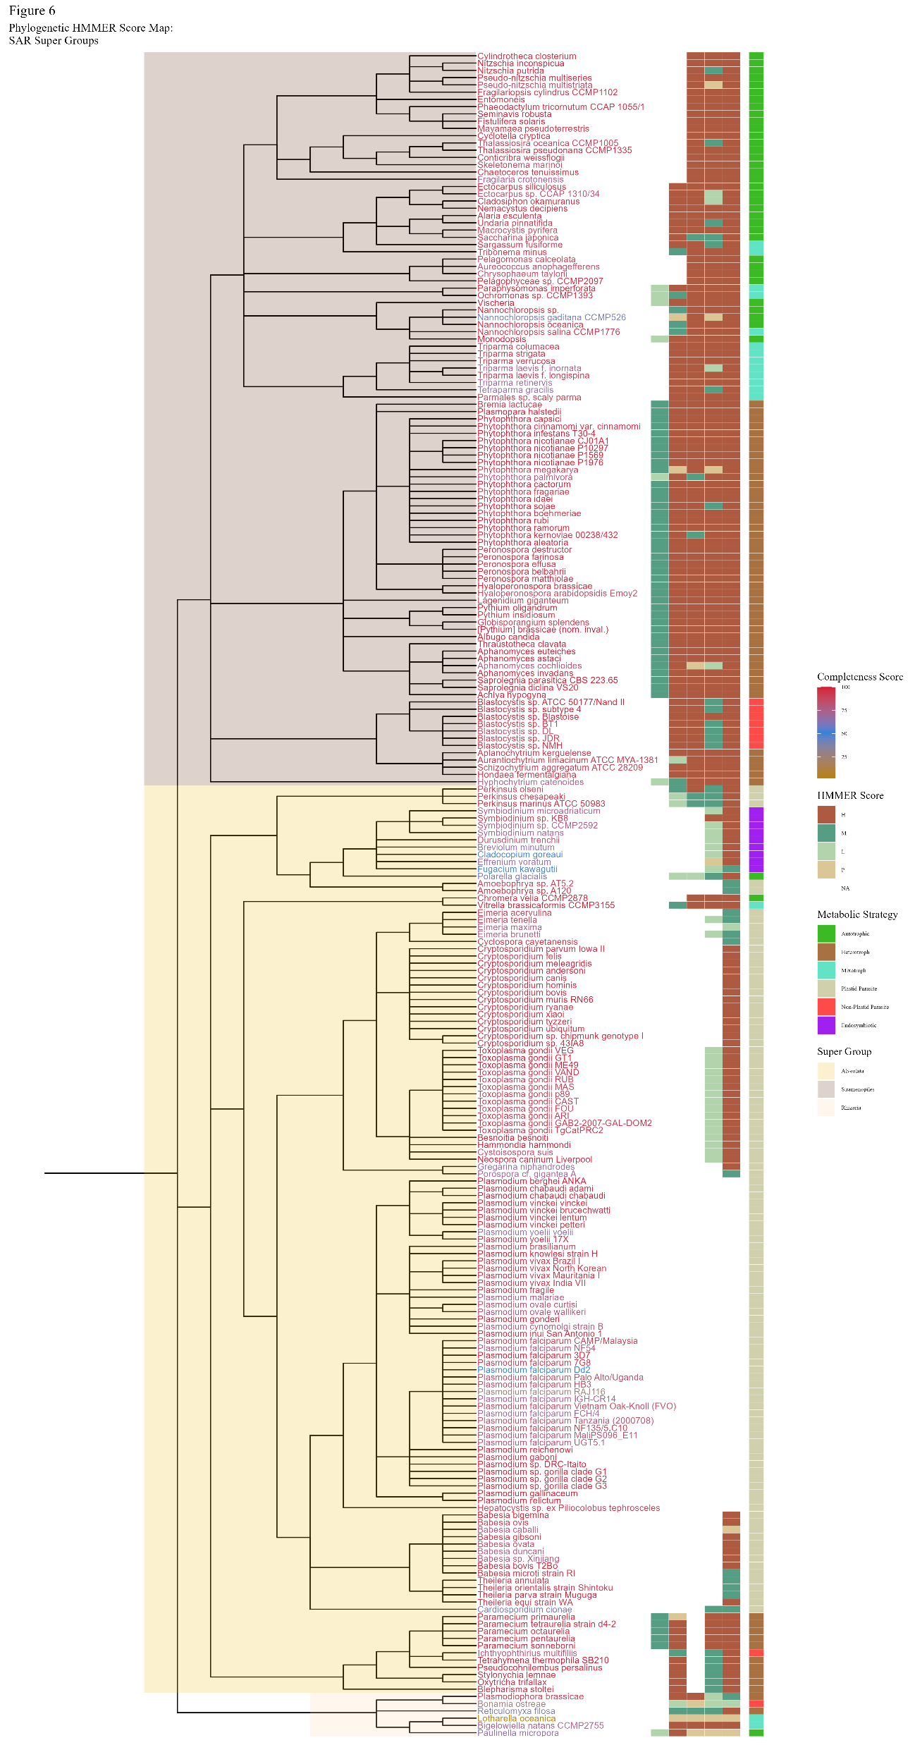
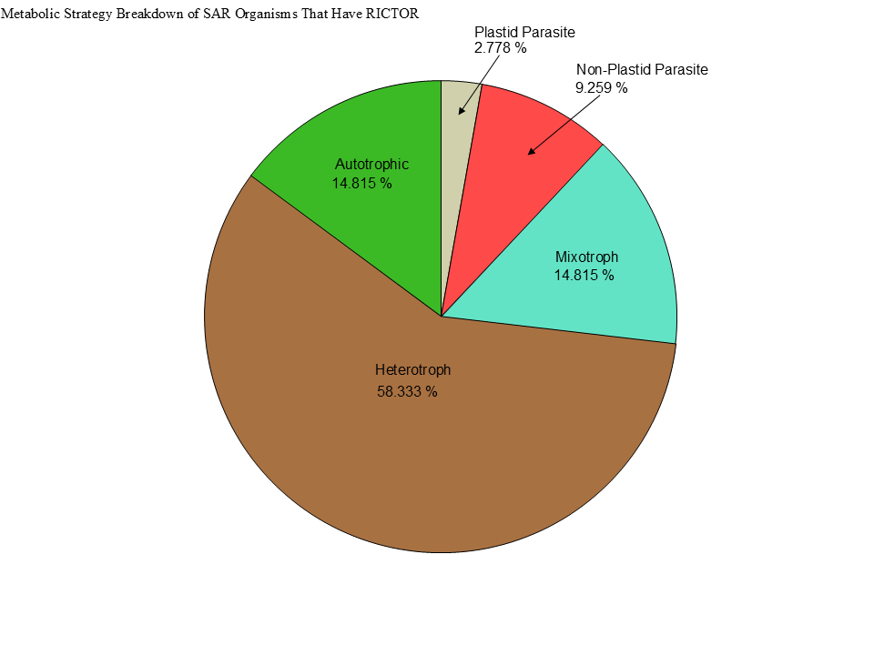


Notes:
Supplemental Possible

Slide 26

Notes:
Supplemental Possible

Slide 27


Figure 7
Metabolic Strategy
Metabolic Strategy
SIN1
RICTOR
LST8
RAPTOR
SIN1
TOR
RICTOR
RAPTOR
LST8
TOR
Rhodophyta
Discoba
Chlorophyta
Metamonada

Slide 28
Rhodophyta
TORC1
TORC2
Archaeplastida
Chlorophyta
TORC1
TORC1
Streptophyta
LECA
TORC1
TORC1
TORC2
Excavates,SAR,Opisthokonta,etc
TORC1
TORC2

Slide 29



Figure 6

Slide 30
Figure 1
MSA
Phylogenetic Tree(s)
Final Images,
Pattern Loss Detection
Genome information from NCBI/JGI
BUSCO/HMMER/BLAST
Combined Dataframes
Graphs/Plots/Tables
Trophic Strategy from literature
SRA/DIAMOND

Slide 31

Figure 1

Slide 32






Figure 3
1
RasGEF
Domain5
1694
RICTORN
RICTORM
RICTOR Phosphorylation
Reference
High
Medium
Low
1
HEAT
ARM Repeats
1353
RAPTORN
ARM Repeats
WD-40 Repeats
Reference
High
Medium

Slide 33
Figure 3
1
1694
RICTORN
RICTORM
RasGEF
Domain5
RICTOR Phosphorylation
ARM Repeats
Reference
High
Medium
Low
1
1353
RAPTORN
ARM Repeats
HEAT
ARM Repeats
WD-40 Repeats
Reference
High
Medium

Slide 34






Metabolic Strategy
LST8
RICTOR
RAPTOR
SIN1
TOR
Stramenopiles
Alveolata
Rhizaria

Slide 36


Slide 37




Figure 3
TOR
LST8
RAPTOR
RICTOR
SIN1

Slide 38
Streptophyta
Secondary Endosymbiosis
Rhodophyta
Primary Endosymbiosis
TORC2
Chlorophyta
Chlorarachniales
TORC1 + TORC2
Rhizaria
TORC1 + TORC2
Primary Endosymbiosis
Archaeplastida
TORC1
LECA
TORC1 + TORC2
Paulinella Micropora
TORC1 + TORC2
SAR
TORC1 +TORC2
Secondary Endosymbiosis
TORC2
Stramenopiles TORC1 + TORC2
Brown Algae
TORC1
Secondary Endosymbiosis
Excavates
TORC1 +TORC2
Tertiary Endosymbiosis
TORC2 + TORC1
Eulena Gracilis
TORC1 + TORC2
Alveolata

Slide 39


Figure 7
Metabolic Strategy
SIN1
RICTOR
RAPTOR
LST8
TOR
Discoba
Metamonada

Slide 40



Metabolic Strategy
Streptophyta
SIN1
RICTOR
RAPTOR
LST8
TOR
Rhodophyta
Chlorophyta

Slide 41



Slide 42





Figure 6

Slide 43


Figure 6

Slide 44



Figure 6

Slide 45
Figure 5

Slide 46
Workflow/Pipeline
NCBI/JGI Genomic Information
MSA
Phylogenetic Tree(s)
Results/TOR Complex Patterns
BUSCO/HMMER/BLAST
R Tables & Taxonomy Tables
Graphs/Data Table
SRA /Diamond Alignment
Notes:
We need to add a start point. Have something that asks the question; what organisms have TORC2 Components and TORC1 Components?

Slide 47
SARs Gain of Plastids:
Losses of TOR Complexes
Rhodophyta Endosymbiosis
Phaeodactylum tricornutum
TORC2 Lost
Macrocystis pyrifera
Stramenopila
Nannochloropsis gaditana
Phytophthora sojae
Expected Heterotrophic Ancestor
TORC1 & TORC2 Present
Stramenopile Endosymbiosis
Polarella glaciallis
Vitrella Brassicaformis
Alveolata
Plasmodium falciparum
Tetrahymena thermophila
Alpha-Cyanobacteria Endosymbiosis
Photoautorophy Loss
Paulinella micropora
TORC1 and TORC2 Lost
Bigelowiella natans
TORC1 Lost
Rhizaria
Chlorophyta Endosymbiosis
Plasmodiophora brassicae

Slide 48
Figure 4

Slide 49


Slide 50


Figure 4

Slide 51
Phylo Trees
HMMER
ClustalO
NCBI/JGI
BLAST
Final Images
Patterns of Loss
Dataframe
BUSCO
DIAMOND
Graphs
Metabolism
Literature
Notes:
We need to add a start point. Have something that asks the question; what organisms have TORC2 Components and TORC1 Components?

Slide 52
Simplified Excavata Gain of Plastids
Chlorophyta Endosymbiosis
Euglenophyceae
Discoba
Kinetoplastea
Eutetramitia, etc.
Expected Heterotrophic Ancestor
TORC1 & TORC2 Present
Metamonada

Slide 53


Slide 54

Figure 1
Metamonada
Opisthokonta
Amoebozoa
Discoba
Rhizaria
Streptophyta
Alveolata
Stramenopila
Rhodophyta
Chlorophyta

Slide 55




Figure 7

Slide 56




Slide 57
Figure 3

Slide 58


Slide 59

Figure 3
TOR
LST8
RAPTOR
RICTOR
SIN1

Slide 60








Figure 2

Slide 61
Metabolic Strategy
LST8
RICTOR
RAPTOR
SIN1
TOR
Stramenopiles
Alveolata
Rhizaria

